Slide 1
T = Take Notes
I = Interact with your notes
P = Practice with plenty of repetition
S = Self-test

Slide 2
Chapter 8 Section 2: Types of Chemical Reactions

Slide 3
Essential questions
What type of reaction is H₂+ O₂ ↔ 2H₂O?
How do chemists know what products will form in a reaction given only reactants?
What is a spectator ion?
When do reactions form precipitates?

Slide 4
Types of Chemical Reactions
Chemical reactions fall into several categories.
Types of chemical reactions | A + X → AX | Synthesis
 | AX → A + X | Decomposition
 | A + BX → AX + B | Single replacement
 | AX + BY → BX + AY | Double replacement
 | X + O₂ → XO C_{x}H_{x} + O₂ → CO₂ + H₂O | Combustion, or Combustion of a hydrocarbon

Slide 5
Synthesis (Combination)reactions
The general form of a synthesis reaction is shown in the diagram.
Example:
MgO + H₂O $→$Mg(OH)₂
Milk of magnesia is a common over-the-counter medication used to neutralize excess stomach acid

Slide 6
Solved problem
Find the product that forms when potassium and chlorine react, then balance the reaction.
Relationships |  | You can tell this is a synthesis reaction because the question asks you to find "the" product; this means there is only one product.
Solve |  | Write the formula for each reactant. Both reactants are elements, so apply the diatomic molecule rule. Chlorine forms a diatomic molecule, but potassium does not: K + Cl₂ → ? Combine K and Cl to form a compound using ionic formula writing rules: Write the ion form for each substance: K⁺ and Cl⁻. Ignore the fact that chlorine is in diatomic form. Criss-cross charges. In this case both charges are "1": KCl Rewrite the reaction with the new compound: K + Cl₂ → KCl Balance the reaction: 2K + Cl₂ → 2KCl
Answer |  | The balanced synthesis reaction is: 2K + Cl₂ → 2KCl

Slide 7
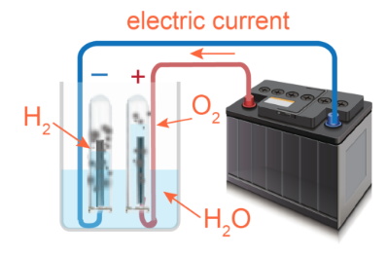
Decomposition reactions
A decomposition reaction breaks one reactant compound into two or more products.

Slide 8
Solved problem
Predict the products and write the balanced reaction for the breakdown of solid barium chlorate, Ba(ClO₃)₂(s).
Relationships |  | There is only one reactant; this is decomposition. Chlorates decompose into a binary salt & oxygen gas.
Solve |  | Break the compound up into molecular oxygen & a salt. Molecular oxygen is O₂(g) Barium and chlorine will form the salt. Write the charges for each ion and perform a criss-cross. Write the cation first in the formula. Charged ions: Ba²⁺ and Cl⁻ Barium chloride: BaCl₂ Write the reaction with the states: Ba(ClO₃)₂(s) → BaCl₂(s) + O₂(g) Balance the reaction: Ba(ClO₃)₂(s) → BaCl₂(s) + 3O₂(g)
Answer |  | The decomposition reaction is balanced as: Ba(ClO₃)₂(s) → BaCl₂(s) + 3O₂(g).

Slide 9
Single replacement reactions
A single replacement reaction occurs when an element takes the place of another element in a compound.

Slide 10
Solved problem
Write the balanced reaction that occurs when chlorine gas and solid sodium bromide react.
Relationships |  | An element and compound react in a single replacement reaction.
Solve |  | Translate reactants to formulas. Apply the diatomic molecule rule to the element chlorine: Cl₂. Write the formula for sodium bromide. Write ions: Sodium = Na⁺ and bromide = Br⁻ Criss-cross charges: Sodium bromide = NaBr Start writing the reaction; include states of matter: Cl₂(g) + NaBr(s) → Determine the products based on chlorine's charge as an ion. Ignore the diatomic nature of chlorine and write it as an ion: Cl⁻. Chlorine is negative so it will replace the negative part of NaBr. When Cl replaces Br, Br will be on its own: Br₂. Cl⁻ combines with Na⁺. Write the positive ion first and criss-cross charges to get the compound: NaCl. Write the complete reaction: Cl₂(g) + NaBr(s) → NaCl(s) + Br₂(g). Balance the reaction: Cl₂(g) + 2NaBr(s) → 2NaCl(s) + Br₂(g).
Answer |  | The balanced single replacement reaction is: Cl₂(g) + 2NaBr(s) → 2NaCl(s) + Br₂(g).

Slide 11
Double replacement reactions
The general form of a double replacement reaction is shown in the diagram.
Double replacement reactions often form a precipitate. A precipitate is a solid that forms when ions from reactants in solution form a compound that is insoluble.

Slide 12
Solved problem
Write the balanced equation for the reaction of lead(II) nitrate with potassium sulfide.
Relationships |  | Two compounds are reacting; this must be double replacement.
Solve |  | Write the ions and criss-cross charges to determine reactant formulas: Ions in lead(II) nitrate: Pb²⁺ and NO₃⁻ Formula after criss-cross: Pb(NO₃)₂ Ions in potassium sulfide: K⁺ and S²⁻ Formula after criss-cross: K₂S Start writing the reaction: Pb(NO₃)₂ + K₂S → ? + ? Write new formulas for each cation; pair it with a new anion. For lead (II): Write ions that will combine: Pb²⁺ and S²⁻ Criss-cross charges; in this case both charges cancel: PbS For potassium: Write ions that will combine: K⁺ and NO₃⁻ Criss-cross charges: KNO₃ Write the reaction: Pb(NO₃)₂ + K₂S → PbS + KNO₃ Balance the reaction: Pb(NO₃)₂ + K₂S → PbS + 2KNO₃
Answer |  | The balanced reaction is: Pb(NO₃)₂ + K₂S → PbS + 2KNO₃

Slide 13
Combustion reactions
Combustion reactions always involve the oxygen molecule as a reactant.
A hydrocarbon is a molecule that only contains hydrogen and carbon. Methane, propane, and butane. When hydrocarbons are combusted, they always form carbon dioxide and water.

Slide 14
Solved problem
Write the balanced reaction for the combustion of magnesium metal.
Relationships |  | In a combustion reaction, the given reactant combines with oxygen to form a product.
Solve |  | Write the reactants. Magnesium does not form a diatomic molecule: Mg Oxygen forms a diatomic molecule: O₂ The reactants are: Mg + O₂ Find the charges of the reactants and criss-cross to form a compound. Magnesium = Mg²⁺ and oxygen = O²⁺ Criss-cross charges; in this case the charges cancel: MgO Write the reaction: Mg + O₂ → MgO Balance the reaction: 2Mg + O₂ → 2MgO
Answer |  | The balanced reaction is: 2Mg + O₂ → 2MgO

Slide 15
Solved problem
Write the balanced reaction for the combustion of pentane, C₅H₁₂.
Relationships |  | This is the combustion of a hydrocarbon. The hydrocarbon will react with oxygen, and the products will be carbon dioxide and water.
Solve |  | 1. When a hydrocarbon undergoes combustion, it reacts with oxygen to produce carbon dioxide and water. No criss-crossing is necessary. C₅H₁₂ + O₂ → CO₂ + H₂O 2. Balance the reaction: Try balancing carbon first, then hydrogen, and balance oxygen last. Keep going back and forth until the reaction is balanced. C₅H₁₂ + 8O₂ → 5CO₂ + 6H₂O
Answer |  | The balanced reaction is: C₅H₁₂ + 8O₂ → 5CO₂ + 6H₂O

Slide 16
Solving chemical story problems
Question: 56.0 g of aluminum reacts with excess copper(II) nitrate. How much copper is produced?
For the time being let’s ignore the 56.0g and focus on finding the balanced equation. There are helpful key words. It says aluminum reacts with copper(II) nitrate. These substances must be reactants and on the left side of the arrow.
The problem goes on to say that copper is produced. Therefore copper is a product and on the right side of the arrow.

Slide 17
Solving chemical story problems - 2
From the pattern, we can see that it is a single replacement reaction. Therefore, the aluminum and nitrate are like the A and X and should be together in a compound on the right.
Now that we have the same kinds of atoms on both sides of the equation, the last step is to balance the equation.

Slide 18
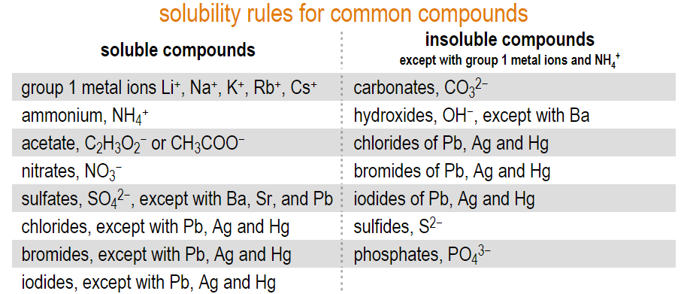
Solubility and precipitation
If something is able to dissolve, it is soluble
Some compounds are more soluble in water than others

Slide 19
Precipitation reaction
A precipitate forms when a product of an aqueous reaction is insoluble.
The potassium and nitrate ions are called a spectator ions because they do not participate in the reaction.

Slide 20
Solved problem
Write the balanced equation for the reaction between magnesium chloride and sodium carbonate solutions. Include compound states.
Relationships | Double replacement reactions occur between 2 compounds
Solve | Write ions for all reactants: Mg²⁺ Cl⁻ Na⁺ CO₃²⁺ Criss-cross; switch cations to get products: MgCl₂ + Na₂CO₃ → MgCO₃ + NaCl Balance the reaction: MgCl₂ + Na₂CO₃ → MgCO₃ + 2NaCl According to solubility rules, everything except MgCO₃ is soluble. MgCl₂(aq) + Na₂CO₃(aq) → MgCO₃(s) + 2NaCl(aq)
Answer | MgCl₂(aq) + Na₂CO₃(aq) → MgCO₃(s) + 2NaCl(aq)

Slide 21
Softening water using precipitation
The process of “watering softening” uses substances that precipitate dissolved minerals.

Slide 22
Solved problem
What reaction occurs when a solution of copper(II) nitrate (Cu(NO₃)₂) is combined with a solution of potassium chloride (KCl)? Write the complete balanced reaction including states.
Relationships | Solubility rules tell us that K⁺, a group 1 metal ion, and nitrates are soluble. Copper is not listed as one of the insoluble chlorides, so it is soluble.
Solve | Crisscross the aqueous reactants to get products: Cu(NO₃)₂(aq) + 2KCl(aq) → CuCl₂(s) + 2KNO₃(aq)
Answer | According to the solubility table, potassium nitrate is soluble and dissociates to K⁺(aq) and NO₃⁻(aq). CuCl₂ is also soluble and exists as dissociated Cu²⁺ and Cl⁻ ions in solution. All ions are balanced.

Slide 23
Net ionic equations
When working with solutions it is common to see only actively reacting ions in the chemical equation.

Slide 24
Solved problem
Write the net ionic equation for: MgCl₂(aq) + Na₂CO₃(aq) → MgCO₃(s) + 2NaCl(aq).
Relationships | The net ionic equation shows only substances that react.
Solve | 1. Break apart aqueous substances and leave solids intact. Include states and coefficients. 2. Cancel ions that appear the same on both sides 3. Rewrite the reaction with the remaining substances. Mg²⁺(aq) + CO₃²⁻(aq) → MgCO₃(s)
Answer | The net ionic equation is: Mg²⁺(aq) + CO₃²⁻(aq) → MgCO₃(s)
Mg²⁺(aq) 2Cl⁻(aq) + 2Na⁺(aq) CO₃²⁻(aq) $→$ MgCO₃(s) + 2Na⁺(aq) 2Cl⁻(aq)

Slide 25
Polymers and polymerization reactions
A polymerization reaction is a repeated addition on monomers into active sites at the end of chains.

Slide 26
Post-assessment
What type of reaction is H₂+ O₂ ↔ 2H₂O?

Slide 27
Post-assessment
What type of reaction is H₂+ O₂ ↔ 2H₂O?
This is a synthesis reaction. The 2-headed arrow has not been explained yet but it looks like the products can re-form reactants.

Slide 28
Post-assessment
How do chemists know what products will form in a reaction given only reactants?

Slide 29
Post-assessment
How do chemists know what products will form in a reaction given only reactants?
You can predict the products if you can identify what type of reaction will occur, for example, if you have a compound and an elemental metal reacting, it will be a single replacement reaction.

Slide 30
Post-assessment
What is a spectator ion?

Slide 31
Post-assessment
What is a spectator ion?
A spectator ion is an ion that is dissolved in an aqueous solution from reactants, that does not participate in a reaction and remains dissolved in solution unchanged.

Slide 32
Post-assessment
When do reactions form precipitates?

Slide 33
Post-assessment
When do reactions form precipitates?
A precipitate forms when aqueous reactants produce a substance that is not highly soluble in water.

