Slide 1
T = Take Notes
I = Interact with your notes
P = Practice with plenty of repetition
S = Self-test

Slide 2
Chapter 7: Section 3: Using Chemical Formulas

Slide 3
ESSENTIAL QUESTION
What is a hydrate?

Slide 4
percent composition
You can identify a compound by the percentage by mass of each element
You can identify a compound by the percentage by mass of each element

Slide 5
Solving percent composition problems
Use the following steps to match an unknown compound with a known chemical formula:
Calculate the masses of each element in the known compound.
From the masses in step (1), calculate the percent compositions of each element.
See if the compositions of known and unknown compounds match within measurement error.

Slide 6
Solved problem
Based on the information given, could the substance be sucrose?
Given
Relationships |  | The % of each element should match the percent composition of sugar if the powder is a sample of that substance.
Solve |  | Find the mass of each element in sucrose; 12 C + 22 H + 11 O = (12 x 12.011) + (22 x 1.0079) + (11 x 15.999) = 342.295 g/mol
Answer |  | The percent composition is similar to the known value. Yes, the sample could be sucrose.

Slide 7
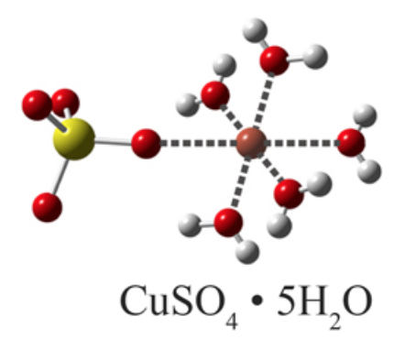
Hydrate percent composition
A hydrate is a substance that has absorbed and incorporated a % of water into its structure
Water can leave the structure when heated
Copper(II) sulfate pentahydrate is an example

Slide 8
Solved problem
A sample of hydrated cobalt(II) chloride is heated and turns from red to blue. Steam also comes out of the test tube. The hydrated sample had a mass of 21.63g. After heating, it has a mass of 11.80. What is the percent water in the hydrate?
Relationships |  | Find the percentage by dividing water mass by total hydrate compound mass, and multiply by 100.
Solve |  | First, determine the mass of water that left the test tube. mass before heating – mass after heating = water mass 21.63 g – 11.80g = 9.83 g Next, divide the water mass by the beginning mass of the hydrate, then multiply by 100 to find the percent water in the hydrate.
Answer |  | The percent composition of water in the cobalt(II) chloride hydrate, CoCl₂•nH₂O is 45.45 %. The "n" in front of H₂O indicates the coefficient is not known, but could be determined mathematically.

Slide 9
Post-assessment
What is a hydrate?

Slide 10
Post-assessment
What is a hydrate?
A hydrate is a substance that has water molecules surrounding its structure.

