Slide 1
T = Take Notes
I = Interact with your notes
P = Practice with plenty of repetition
S = Self-test

Slide 2
Chapter 7: Section 2: Oxidation numbers

Slide 3
Follow the rules

Slide 4
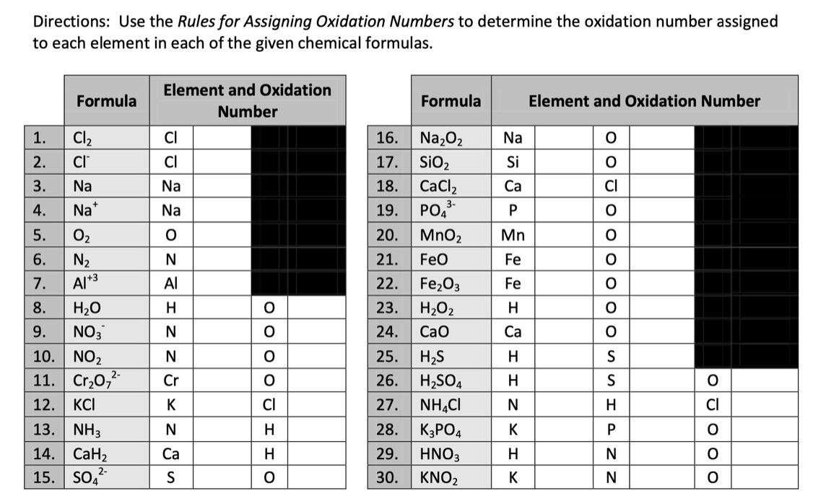
Practice

Slide 5
Solved problem

