Slide 1
T = Take Notes
I = Interact with your notes
P = Practice with plenty of repetition
S = Self-test

Slide 2
Chapter 7: Section 4: Determining Chemical Formulas

Slide 3
ESSENTIAL QUESTIONS
How are percentages used to identify an unknown chemical?
What is the difference between an empirical formula and a molecular formula?

Slide 4
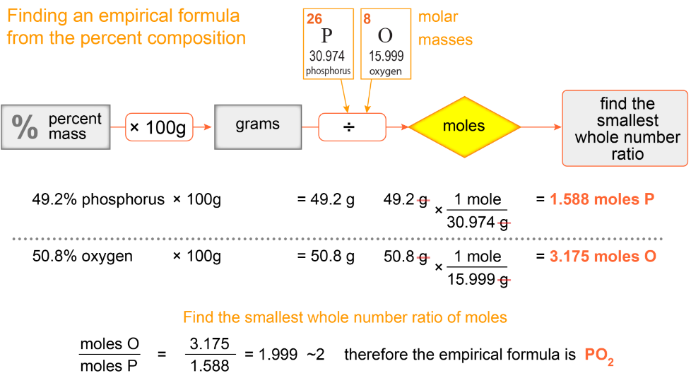
The empirical formula
An empirical formula is the simplest ratio of elements in a compound.
All ionic formulas are empirical, and many molecular formulas are empirical.

Slide 5
Solved problem
Which of the following is an empirical formula and which is a molecular formula? CH₄, C₆H₆, P₂O₁₀, CaCl₂ and Al₂O₃?
Relationships |  | The subscripts have to be in the simplest ratio to be an empirical formula.
Solve |  | CH₄, CaCl₂ and Al₂O₃ are in the simplest ratio C₆H₆ and P₂O₁₀ are molecular formulas and can be simplified to CH and PO₅. Methane, CH₄ is an example of a substance that is the simplest and the actual ratio.
Answer |  | CH₄, CaCl₂ and Al₂O₃ are empirical formulas; C₆H₆ and P₂O₁₀ are molecular formulas. CH₄ is both an empirical and molecular formula.

Slide 6
Finding the mole ratio in an empirical formula
For a two-element compound divide the larger number of moles by the smaller.
For a compound with more than two elements find the element with the smallest number of moles.
Divide the moles of each of the other elements by the moles of the element with the smallest number of moles.

Slide 7
Solved problem
You find a jar of powder labeled nickel chloride, but you know it should have a Roman numeral in the name because nickel can be Ni²⁺ or Ni³⁺. After taking a 54.50 g sample, you find that it is made of 19.40 g of nickel and 35.10 g of chlorine. What is the name and formula of the powdered compound?
Relationships |  | The mole ratio of elements can be simplified to give an empirical formula.
Solve |  | Use the given masses to determine moles of each atom, then divide moles of each atom by the lowest number of moles.
Answer |  | The formula is NiCl₃, nickel(III) chloride.

Slide 8
Solved problem
A five gram sample of a material has the following composition: 2.003 g of calcium, 0.600 g carbon and 2.397 g oxygen. What is the empirical formula of the compound?
Relationships |  | The mole ratio of elements can be simplified to give an empirical formula.
Solve
Answer |  | The empirical formula is CaCO₃.

Slide 9
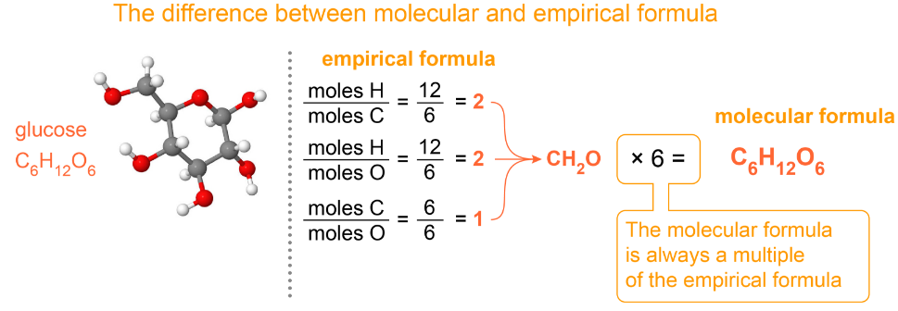
Calculating molecular formulas
An empirical formula tells you the ratio of elements in a molecule, but not how many atoms of each there are
To find a molecular formula from an empirical formula you need the molar mass of the compound

Slide 10
Calculating molecular formulas - 2
The molecular formula will always be a multiple of the empirical formula therefore the molar mass of the molecule will be a multiple of the molar mass of the empirical formula.

Slide 11
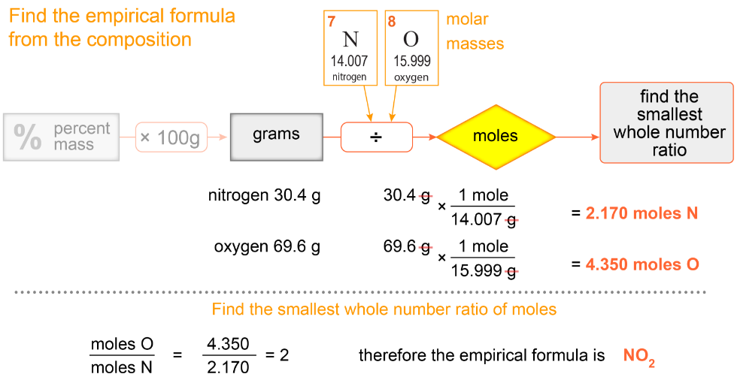
Putting it all together

Slide 12
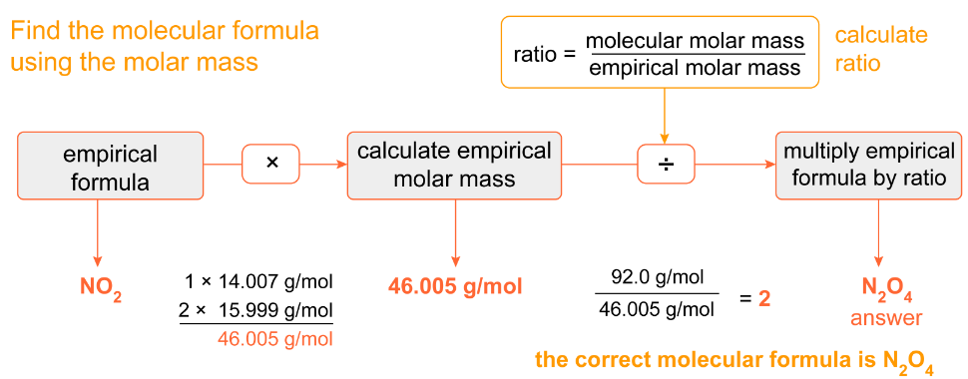
Putting it all together - 2

Slide 13
Post-assessment
How are percentages used to identify an unknown chemical?
The percentages can be used to find the empirical formula of the unknown chemical.

Slide 14
Post-assessment
What is the difference between an empirical formula and a molecular formula?

Slide 15
Post-assessment
What is the difference between an empirical formula and a molecular formula?
There is no difference for ionic substances, however for molecular substances, the empirical formula is the most reduced form of the chemical formula.

