Slide 1
T = Take Notes
I = Interact with your notes
P = Practice with plenty of repetition
S = Self-test

Slide 2
Chapter 7: Section 1: Chemical Names and Formulas

Slide 3
ESSENTIAL QUESTIONS
What is the formula for potassium oxide?
What is the formula for calcium hydroxide?
How do you name Fe₂O₃?
How do you name (NH₄)₃PO₄?

Slide 4
Compound names
A binary compound is a compound that contains only two atoms or atoms.
Ions combine to create a chemical formula that is electrically neutral.

Slide 5
Solved problem
Name each of the following binary ionic compounds: a) CaO; b) SrCl₂; c) LiI; d) ZnF₂; e) KBr; f) BeS
Asked | Apply naming rules to the compounds above.
Solve | The first element in each compound is a metal cation. Use its element name. The second element is a nonmetal anion. Change its ending to –ide
Answer | a) calcium oxide; b) strontium chloride; c) lithium iodide d) zinc fluoride; e) potassium bromide; f) beryllium sulfide

Slide 6
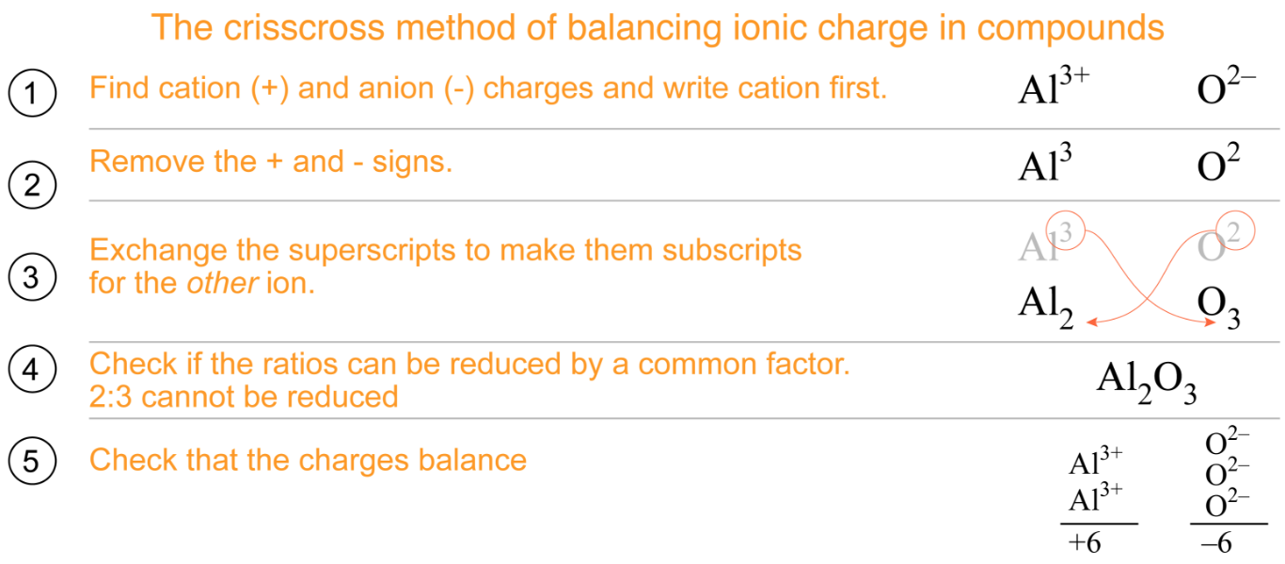
The crisscross method: Binary compounds

Slide 7
Solved problem
Write the formula for calcium sulfide.
Asked | Use the crisscross method to find the chemical formula
Solve | Follow the four steps of a crisscross: Step 1: Calcium: Ca²⁺ Sulfide: S²⁻ Step 2: Remove + and − signs: Ca² S² Step 3:Crisscross numbers to the opposite element: Step 4: Ca₂S₂ has a ratio of 2:2, which can be reduced to 1:1. The number 1 is invisible in chemical formulas. Ca₂S₂→ CaS
Answer | The formula for calcium sulfide is CaS.

Slide 8
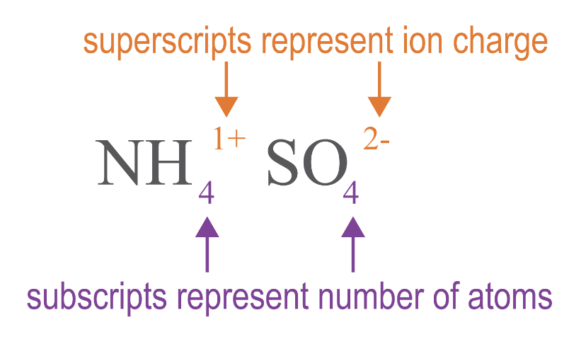
Superscripts vs. subscripts
Superscripts tell you the charge, and subscripts tell you the number of atoms.

Slide 9
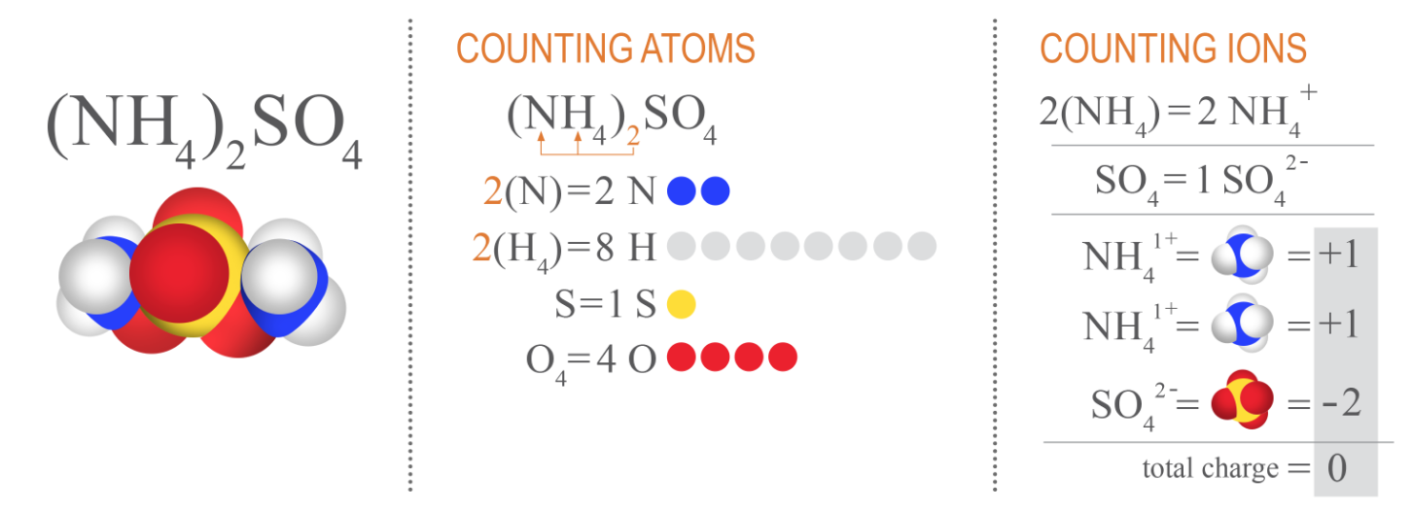
Counting atoms and counting ions
For compounds such as ammonium sulfate, (NH₄)₂SO₄. The subscript ₂ outside the parentheses is distributed only to the atoms inside the parentheses by multiplication as shown below.

Slide 10
Ternary and quaternary ionic compounds
A ternary compound contains three different elements.
A quaternary compound contains four different elements.
These compounds contain at least one polyatomic ion.
Naming these compounds is similar to binary compounds because they consist of a cation and an anion.

Slide 11
Solved problem
Name the following compounds: a) Ca(OH)₂; b) RbNO₂; c) NH₄Cl; d) Al₂(SO₄)₃
Asked | Apply naming rules to the compounds above.
Relationships | Cations receive their element name except for ammonium, NH₄. Polyatomic anions receive the name listed in the polyatomic ion chart. Monatomic anions change their ending to -ide.
Solve | Split each compound after the cation. Give each half its appropriate name: a) Ca | (OH)₂; b) Rb | NO₂; c) NH₄ | Cl; d) Al₂ | (SO₄)₃
Answer | a) calcium hydroxide; b) rubidium nitrite; c) ammonium chloride; d) aluminum sulfate

Slide 12
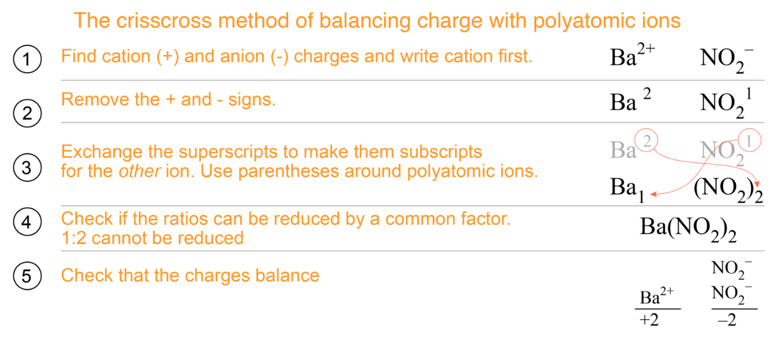
The crisscross method: Ternary compounds
Example 1

Slide 13
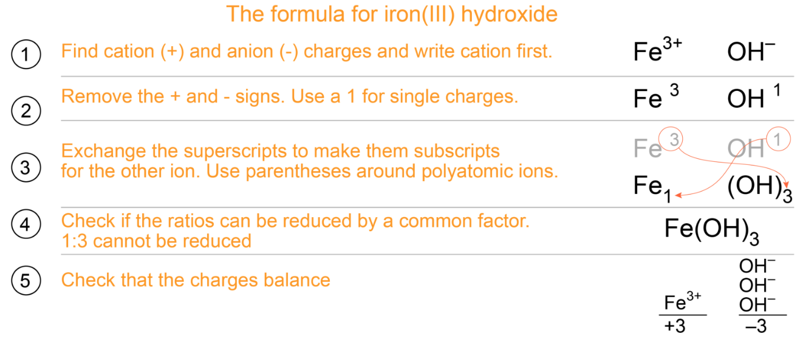
The crisscross method: Ternary compounds
Example 2

Slide 14
Ionic formulas with Roman numerals
Some metals always form the same ion with the same charge but many metals can form ions with different charges.

Slide 15
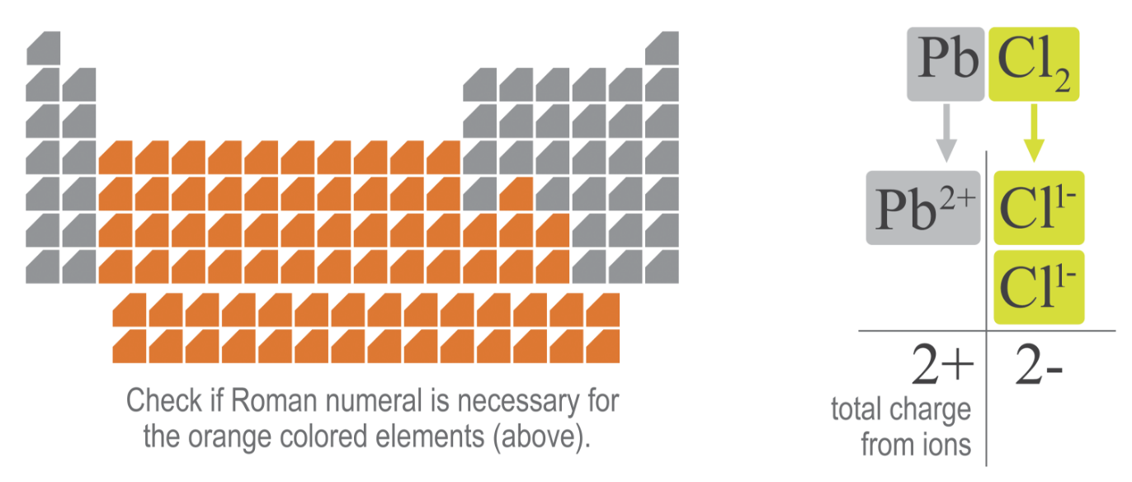
Transition metals use Roman numerals

Slide 16
Post-assessment
What is the formula for potassium oxide?

Slide 17
Post-assessment
What is the formula for potassium oxide?
K₂O

Slide 18
Post-assessment
What is the formula for calcium hydroxide?

Slide 19
Post-assessment
What is the formula for calcium hydroxide?
Ca(OH)₂

Slide 20
Post-assessment
How do you name Fe₂O₃?

Slide 21
Post-assessment
How do you name Fe₂O₃?
This is binary so the cation gets its regular name, and the anion changes its ending to –ide. However, Fe needs a Roman numeral. A reverse crisscross helps determine the name: iron(III) oxide.

Slide 22
Post-assessment
How do you name (NH₄)₃PO₄?

Slide 23
Post-assessment
How do you name (NH₄)₃PO₄?
This is quaternary so each polyatomic ion gets its name. This is ammonium phosphate.

