Slide 1
T = Take Notes
I = Interact with your notes
P = Practice with plenty of repetition
S = Self-test

Slide 2
Chapter 6 Sestion 1: Introduction to Chemical Bonding

Slide 3
ESSENTIAL QUESTIONS
How are chemical bonds formed?
Why do atoms form bonds?
What do dots on a Lewis dot diagram represent?
How do you know where to create a bond on a Lewis dot diagram?
What is the octet rule?

Slide 4
Compounds
A compound is a substance that contains atoms of two or more different elements that are chemically bound together.
A chemical bond is a strong attraction between atoms that hold compounds together.

Slide 5
What are chemical bonds?
A chemical bond is a relatively strong attraction between a pair of electrons in neighboring atoms.
The diagrams below shows four different ways to represent a methane molecule (CH₄).

Slide 6
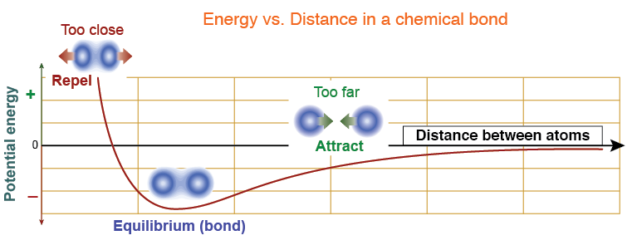
How chemical bonds form
A diatomic molecule is composed of only two elements.
As two atoms get close to each other, the attraction between one atom's valence electrons and the nucleus of the other atom creates a slight polarization of each electron cloud.
When two atoms get too close to each other, the force between them becomes repulsive.
A chemical bond forms at this equilibrium distance as seen in the diagram.

Slide 7
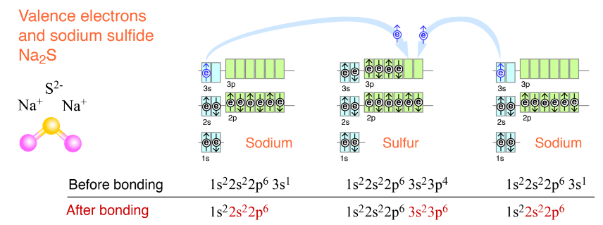
Bonding and electron configurations
Atoms bond to form complete energy levels.
The diagram below shows how both elements can reach the lowest-energy condition of having full energy levels by sharing two pairs of electrons. Each shared pair represents a chemical bond.

Slide 8
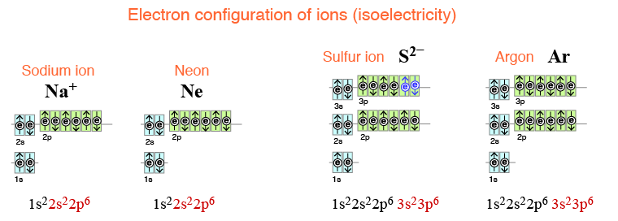
Isoelectronic particles
Different elements with the same electron configuration are isoelectronic.

Slide 9
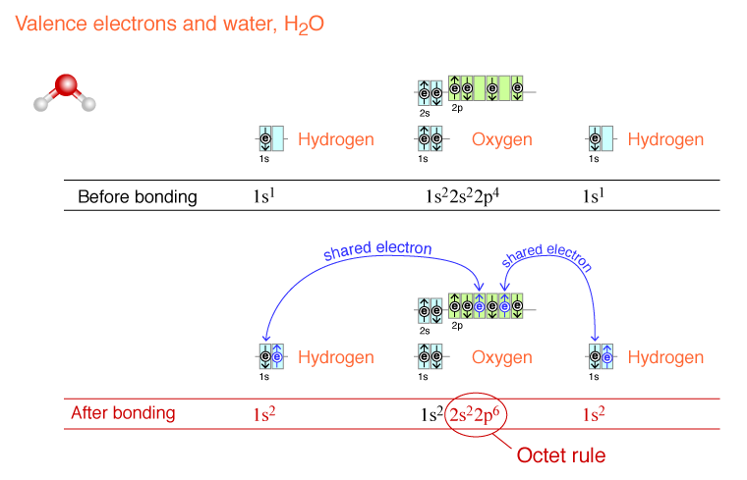
The octet rule
The rule that compounds form so as to give every atom eight valence electrons is called the octet rule.
Eight valence electrons completely fill the s and p orbitals.
Full energy levels are very stable.

Slide 10
Solved problem
Use the octet rule to determine how many atoms of fluorine and carbon will bond together.
Relationships | Atoms combine so each has an octet of valence electrons.
Solve | Fluorine has an electron configuration of 1s²2s²2p⁵ and therefore has seven valence electrons. It only needs one more electron to reach octet. Carbon has four valence electrons. Since carbon has the greater number of single electrons, it will add as many fluorine atoms as possible to reach octet. It needs four more electrons to reach octet.
Answer | Four F atoms combine with 1 C atom

Slide 11
Bond summary
 | Ionic | Coval Covalent | Metallic
Bonding between Types of Elements | Metal plus Nonmetal | Nonmetals only | Metals only
Electrons | Transfer of electrons | Sharing of electrons | Freely moving in a sea of electrons
Physical Properties: Melting, Boiling, etc | High | Low | Lowest
Chemical Properties: Conduct Electricity | Yes (when dissolved or molten/liquid) | No | Yes because of free mobile electrons
Soluble in Water | Yes | Sometimes | No
Product of Bonding | Ions or crystalline solids | Molecules | Alloys

Slide 12
Light elements
The octet rule is really a "duet" rule for hydrogen, helium, lithium, and beryllium.
These elements are Isoelectronic with He and only need two electrons to complete their energy levels.

Slide 13
Written chemical formulas
Compounds have a unique chemical formula that tells you how many of each kind of atom are in the compound.

Slide 14
Drawings of formulas
In drawings, atoms are in their elemental or atomic form if they are separated and there are no lines connecting them.
If atoms overlap with each other, or they are connected with a solid line, then they are combined as a compound.
The solid line represents chemical bonds.

Slide 15
Representing molecules
In chemistry, structure means how the atoms are connected to each other.

Slide 16
Lewis dot diagram and electron pairs
A Lewis dot diagram is convenient way to represent the idea of paired valence electrons and the stable arrangements of eight or two
Sulfur is shown below; the element symbol is written in the center and the valence electrons are written around the symbol
The pairing of dots in Lewis dot diagrams reflect Hund's rule.
Only the unpaired electrons are available for making chemical bonds.

Slide 17
Lewis dots and molecular structure
Consider a molecule of ethanol (C₂H₅OH).
Each carbon atom is surrounded by eight dots (4 bonds).
Each oxygen atom is also surrounded by eight dots (two bonds).
Each hydrogen atom in the molecule contributes its single 1s valence electron and forms one bond (two dots).
All of the atoms have complete energy levels.

Slide 18
Solved problem
Draw the Lewis dot diagram for one possible structure for propene C₃H₆.
Solve | Draw Lewis dot diagrams for one C atom and one H atom: Carbon has more single electrons so bond atoms to it first. Connect all 3 C atoms. Now add the 6 H atoms. Move leftover single electrons into a double bond.
Answer

Slide 19
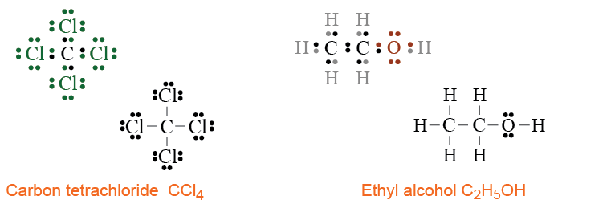
Structural diagrams
In a structural diagram, a line represents a bonded pair of electrons between atoms.
It is easier to see bonds in structural diagrams.

Slide 20
Double and triple bonds
To meet the octet rule each atom in O₂ must share two pairs of electrons with its partner in a double bond.
Each nitrogen atom in N₂ must share three pairs of electrons in a triple bond.
Many molecules may contain a single bond together with double or triple bonds.

Slide 21
Post-assessment
What is the difference between an element and a compound?

Slide 22
Post-assessment
What is the difference between an element and a compound?
An element is one or more of the same kind of atom but a compound is made of 2 or more different elements chemically bound together.

Slide 23
Post-assessment
How are chemical bonds formed?

Slide 24
Post-assessment
How are chemical bonds formed?
Chemical bonds are formed when atoms share or exchange their valence electrons to get a noble gas configuration or octet.

Slide 25
Post-assessment
Why do atoms form bonds?

Slide 26
Post-assessment
Why do atoms form bonds?
Atoms form chemical bonds to get a more stable electron configuration.

Slide 27
Post-assessment
What are the parts of a chemical formula?

Slide 28
Post-assessment
What are the parts of a chemical formula?
There are chemical symbols and subscripts, the subscripts let you know how many of each atom there are in the formula.

Slide 29
Post-assessment
What do dots on a Lewis dot diagram represent?

Slide 30
Post-assessment
What do dots on a Lewis dot diagram represent?
Valence electrons.

Slide 31
Post-assessment
How do you know where to create a bond on a Lewis dot diagram?

Slide 32
Post-assessment
How do you know where to create a bond on a Lewis dot diagram?
Unpaired electrons are available to form bonds.

Slide 33
Post-assessment
What is the octet rule?

Slide 34
Post-assessment
What is the octet rule?
Atoms surrounded with 8 valence electrons are stable.

Slide 35
Post-assessment
What is the value of having several different molecular models?

Slide 36
Post-assessment
What is the value of having several different molecular models?
If you want to know different information about a molecule, you should choose the model that best represents that information, such as what the molecule looks lie in 3D space or simply in what order the atoms are arranged.

