Slide 1
T = Take Notes
I = Interact with your notes
P = Practice with plenty of repetition
S = Self-test

Slide 2
Chapter 6 Section 1: Types of Bonds

Slide 3
ESSENTIAL QUESTIONS
What are the types of bonds?
How does electronegativity affect bonding?
What kind of information can you gain from an atom’s electron configuration?

Slide 4
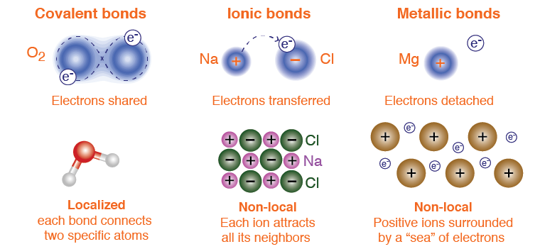
Three bond types
In this section, we will learn how the type of bond is determined by two factors.
One factor is how strongly each atom "attracts" electrons from neighboring atoms (electronegativity).
The second factor is whether the bond is localized to a single pair of atoms (covalent) or acts between many neighboring atoms (metallic and ionic).

Slide 5
Bonding and energy
Chemical bonds occur because systems tend to rearrange themselves into the configuration with the lowest energy.
In a system of two hydrogen atoms, there are unfilled electron "vacancies" in the first energy level.
Two hydrogen atoms can achieve lower energy by forming a bond.
In the compound H₂, each atom shares both electrons so that each atom can get to the lowest energy state with full energy levels.

Slide 6
Electronegativity
Electronegativity describes how strongly an atom attracts electrons from another atom.
The trend for electronegativity is that it increases as you move up and to the right on the Periodic Chart.

Slide 7
Non-polar covalent bonds
The difference in electronegativity between two bonded atoms predicts whether the bond will be ionic, covalent or somewhere in-between.
A non-polar covalent bond occurs when electrons are equally shared between bonded atoms. Bonds between atoms with an electronegativity difference of 0.5 or less are non-polar covalent.

Slide 8
Polar covalent bonds
Elements with an electronegativity difference between 0.5 and 2.1 form a polar covalent bond.

Slide 9
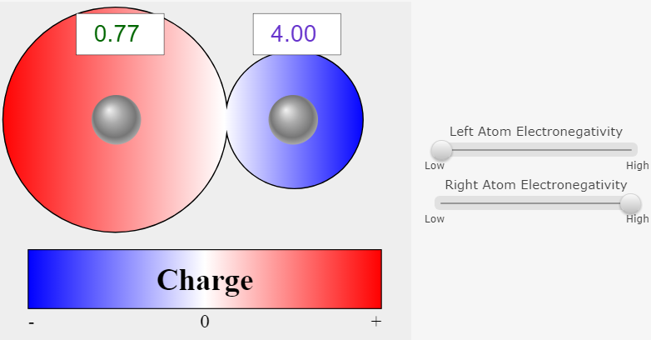
Interactive
See how electronegativity difference affects charge distribution between two bonded atoms in the interactive simulation titled “Electronegativity.”

Slide 10
Polar and non-polar molecules
A polar molecule has a charge separation for the whole molecule - not just an individual bond.
Whether a molecule is polar or non-polar depends on the location and polarity of the individual bonds.

Slide 11
Carbon dioxide
Carbon dioxide has two polar bonds opposite each other in a linear molecule.
Neither end of the molecule has a different charge than the other end so there is no favored orientation and the overall molecule is non-polar.

Slide 12
Ionic bonds
An ionic bond forms when the difference in electronegativity is larger than 2.1.
Because they connect multiple atoms, ionic bonds are not represented with lines on structural diagrams. Instead, the + and - signs indicate the charge of each ion.

Slide 13
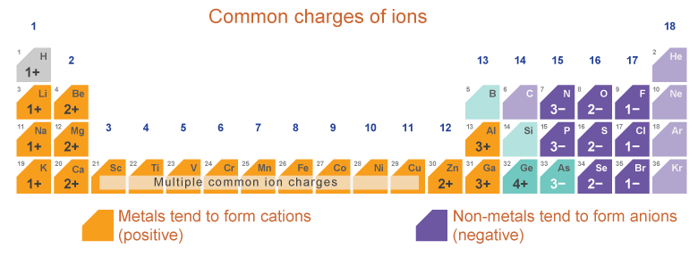
Common charges of ions
Most elements can form ionic compounds
The table below shows the most common charges for ions of the main group elements
Left-side elements (metals) form positive ions, right-side elements (non-metals) form negative ions
Elements located between metal and non-metal elements form both positive and negative ions.

Slide 14
Electron configuration and ions
The charge of an ion depends on how many electrons it must gain or lose to achieve a full energy level.

Slide 15
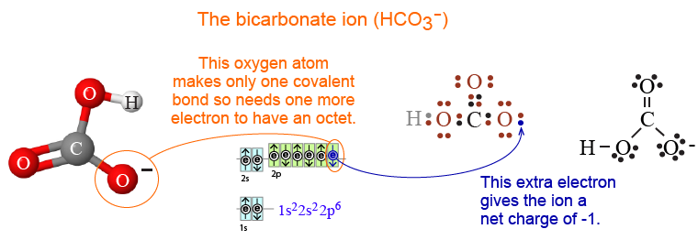
Polyatomic ions
In many compounds, the "ion" is actually a "charged molecule" consisting of several atoms covalently bonded together.
Polyatomic ions occur when covalently bonded atoms pick up or lose electrons instead of making more bonds with other atoms.

Slide 16
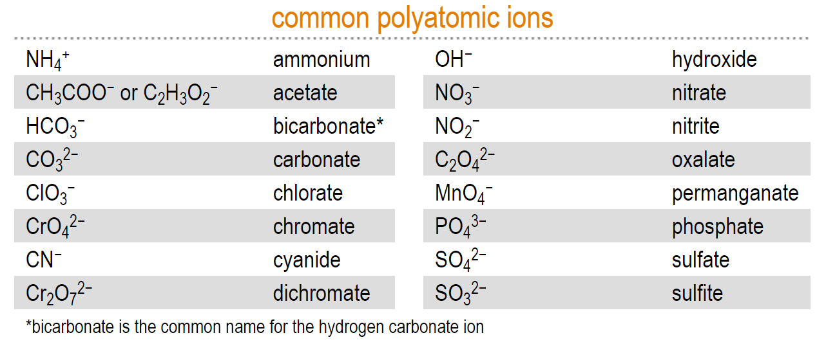
Polyatomic ions
A polyatomic ion is a molecule with a charge and can be negative or positive.
The chart below lists some common polyatomic ions.

Slide 17
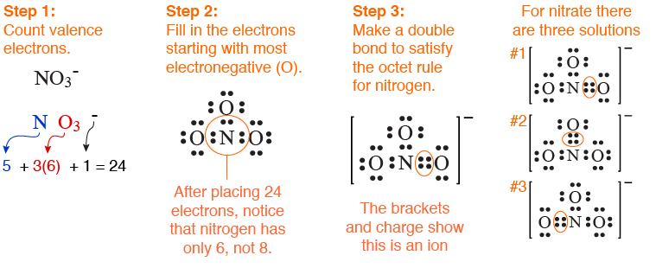
Making a polyatomic ion structure
The diagram below shows the steps for making the structure of nitrate ion.

Slide 18
Partial charges
Notice the brackets and the minus sign (-) on the Lewis dot diagram that indicate that the structure is an ion with a -1 charge.
The chemistry of polyatomic ions often depends on which of the atoms carries the charge of the ion. In the case of nitrate, we assign a partial charge to the pair of single-bonded oxygen atoms.
Partial charges are symbolized by the lower-case Greek letter delta, δ.

Slide 19
Simple ionic compounds
Ionic substances typically form a crystal.
The crystal is neutral because there are exactly equal numbers of positive and negative charges.
You can have any number of ions in the crystal as long as the positive charges exactly balance the negative charges.

Slide 20
Metals and metallic bonds
A metal is a substance that is a good conductor of electricity (and heat).
In a metallic bond the valence electrons are shared among all atoms in the entire material. The mobile (detached) electrons are the reason metals are good conductors of electricity.

Slide 21
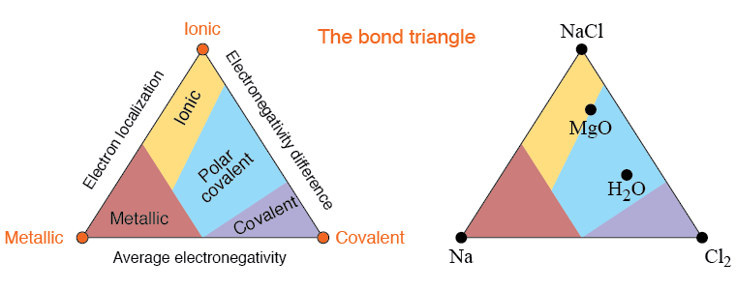
The bond triangle
The bond triangle shows the relationships between ionic, metallic and covalent bonds. Each corner of the triangle represents one of the three pure types: metallic, covalent, and ionic.

Slide 22
Bond summary
 | Ionic | Coval Covalent | Metallic
Bonding between Types of Elements | Metal plus Nonmetal | Nonmetals only | Metals only
Electrons | Transfer of electrons | Sharing of electrons | Freely moving in a sea of electrons
Physical Properties: Melting, Boiling, etc | High | Low | Lowest
Chemical Properties: Conduct Electricity | Yes (when dissolved or molten/liquid) | No | Yes because of free mobile electrons
Soluble in Water | Yes | Sometimes | No
Product of Bonding | Ions or crystalline solids | Molecules | Alloys

Slide 23
Post-assessment
What are the types of bonds?

Slide 24
Post-assessment
What are the types of bonds?
The three types of bonds are: ionic, covalent, and metallic.

Slide 25
Post-assessment
How does electronegativity affect bonding?

Slide 26
Post-assessment
How does electronegativity affect bonding?
The greater the electronegativity difference, the more likely the bond is to be ionic. If electronegativity difference is small, the bond will be either polar covalent or nonpolar covalent. Nonpolar covalent bonds have the smallest electronegativity difference.

Slide 27
Post-assessment
What kind of information can you gain from an atom’s electron configuration?

Slide 28
Post-assessment
What kind of information can you gain from an atom’s electron configuration?
You can predict how many electrons the atom might lose or gain if it were to form an ion; or you can determine whether it is stable, or if it is likely to form a bond in order to increase its stability. You can also predict the properties of the atom or ion it is likely to bond to.

