Slide 1
T = Take Notes
I = Interact with your notes
P = Practice with plenty of repetition
S = Self-test

Slide 2
Chapter 6 Section 3: Ionic Bonding

Slide 3
ESSENTIAL QUESTIONS
How does the charge of an ion relate to electron transfer?
What characteristics would a substance have if it was held together with ionic bonds?
What is a polyatomic ion?

Slide 4
The charge of ions
An ion is an atom or molecule that is either positively or negatively charged.
An ion is created when a neutral atom accepts or donates one or more electrons.
An atom that accepts an electron becomes a negatively charged ion with a charge of 1-.
An atom that donates an electron becomes a positively charged ion with a charge of 1+.

Slide 5
Solved problem
Calculate the number of electrons each ion has lost or gained: Li⁺, S²⁻, Al³⁺
Given | Use atomic number and charge to determine how many electrons have moved into or out of each ion.
Relationships | Positive charges result from electron loss, negative charges result from electron gain. Use atomic number for number of protons. Compare the number of protons to the charge to calculate the number of electrons lost or gained.
Solve | Li⁺: Positive charges indicate lost electrons: 1+ = 3 protons vs. 2 electrons S²⁻: Negative charges indicate gained electrons: 2- = 16 protons vs. 18 electrons Al³⁺: Positive charges indicate lost electrons: 3+ = 13 protons vs. 10 electrons
Answer | Li⁺ lost 1 electron; S²⁻ gained 2 electrons; Al³⁺ lost 3 electrons.

Slide 6
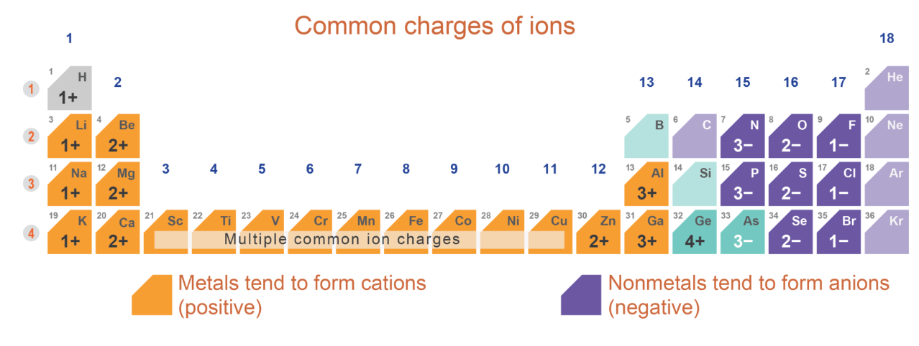
Cations and Anions
Non-metals typically gain electrons to form a negative anion.
Metals typically lose electrons to form a positive cation.

Slide 7
Ionic compounds
An ionic compound is a substance in which the attractive force acts between positive and negative ions.

Slide 8
The formula unit
One NaCl "particle" is called a formula unit.

Slide 9
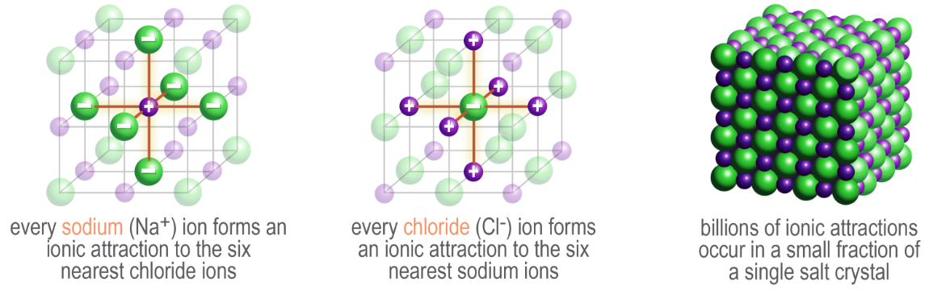
Ionic crystal structures
Every positive ion is surrounded by many negative ions in a fixed ratio
Every negative ion is surrounded by many positive ions in a fixed ratio
In NaCl, each Na⁺ ion is surrounded by 6 Cl – ions and each Cl – ion is surrounded by 6 Cl – ions (1:1 ion ratio)

Slide 10
Properties of ionic compounds
Ionic substances tend to have very similar properties. They typically:
form crystals that are hard yet easily shatter
are solid at room temperature
have very high melting points; it takes a lot of energy to melt them
conduct electricity if heated to a liquid state (but not in a solid state)
conduct electricity when dissolved in water or other liquid
separate into their component ions to some degree when dissolved in water

Slide 11
Polyatomic ions
A polyatomic ion is a groups of bonded atoms that carry a charge.

Slide 12
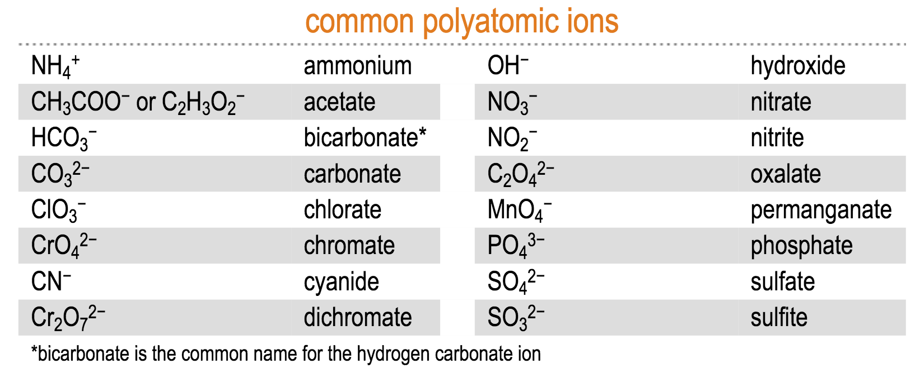
Common polyatomic ions

Slide 13
Post-assessment
How does the charge of an ion relate to electron transfer?

Slide 14
Post-assessment
How does the charge of an ion relate to electron transfer?
If electrons are transferred away from an atom, a positive ion is formed. If electrons are transferred towards an atom, a negative ion is formed. The number on the charge relates to the number of electrons transferred.

Slide 15
Post-assessment
What characteristics would a substance have if it was held together with ionic bonds?

Slide 16
Post-assessment
What characteristics would a substance have if it was held together with ionic bonds?
The substance could be a hard but brittle solid crystal, with a high melting and boiling point. It can conduct electricity if it is melted or if it is dissolved in water.

Slide 17
Post-assessment
What is a polyatomic ion?

Slide 18
Post-assessment
What is a polyatomic ion?
A polyatomic ion is an ion that has more than one atom in its formula.

