Slide 1
T = Take Notes
I = Interact with your notes
P = Practice with plenty of repetition
S = Self-test

Slide 2
Chapter 6 Section 5: Molecular Geometry

Slide 3
ESSENTIAL QUESTIONS
What are some examples of properties of matter that are influenced by intermolecular force strength?
Why is a hydrogen bond not a true bond?
What properties of water are made possible by hydrogen bonding?
How many different intermolecular forces can you think of, and can you rank them from strongest to weakest?
What is the distinguishing factor between an “attraction” and a “bond”?

Slide 4
Intermolecular forces
The forces that hold atoms and molecules together to form solids and liquids are called intermolecular forces.
The types of intermolecular forces are,
Dipole-dipole attractions
Hydrogen Bonds
London Dispersion Forces
Ionic charges
Metallic bonds
Network covalent bonds

Slide 5
Water and hydrogen bonding
The charge separation in a water molecule is called a dipole because there are two different charged ends.
The attraction between the charged regions of neighboring polar molecules is called a dipole–dipole attraction.
The strong dipole-dipole force involving hydrogen is called a hydrogen bond.

Slide 6
Polar substances
Oil and water do not mix because water is a polar molecule and oil is nonpolar
Water and alcohol mix because both are polar
Substances with similar polarity mix with each other
In chemistry, there is a saying, “Like dissolves like.”
This refers to the polarity of the molecules.

Slide 7
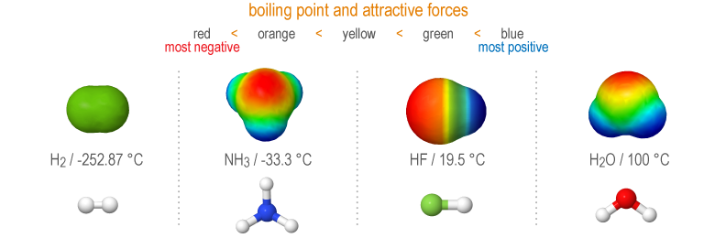
Polarity and boiling point
The three solvents below have increasing polarity resulting in increasing boiling points

Slide 8
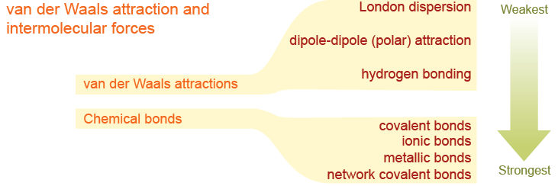
Van der Waals attractions
The London dispersion and dipole-dipole forces between atoms and molecules are collectively know as van der Waals attractions.
van der Waals attractions are weaker intermolecular attractive forces while chemical bonds are stronger intramolecular forces

Slide 9
Ionic substances
The forces between ions in ionic compounds are comparable to chemical bonds, and much stronger than dipole or London dispersion forces.
For this reason, ionic substances tend to have similar physical properties. Ionic substances are usually brittle and hard.
Ionic substances form crystalline solids.
Ionic substances are solid at room temperature and have very high melting points.
Ionic substances become conductive when melted or dissolved in water or other polar solvents.

Slide 10
Sodium chloride
The structure of table salt alternates sodium ions with chloride ions and is called a lattice.

Slide 11
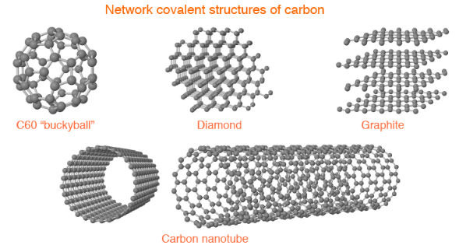
Network covalent substances
In a network covalent structure every atom is bonded to neighboring atoms in an interconnected mesh.
Network covalent structures are very strong. To scratch diamond you have to break chemical bonds not just intermolecular forces.

Slide 12
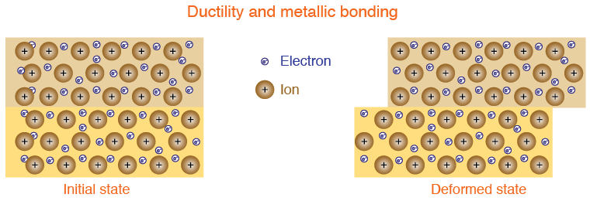
Metals and alloys
Metals have the unusual properties of being strong but also ductile.
A material is ductile if it bends or deforms without breaking.
The ductility of metals comes from the metallic bond's combination of strength combined with non-localized electrons.

Slide 13
Post-assessment
What are some examples of properties of matter that are influenced by intermolecular force strength?

Slide 14
Post-assessment
What are some examples of properties of matter that are influenced by intermolecular force strength?
Properties include melting point, boiling point, hardness, solubility, and surface tension.

Slide 15
Post-assessment
Why is a hydrogen bond not a true bond?

Slide 16
Post-assessment
Why is a hydrogen bond not a true bond?
A hydrogen bond is an attractive force that is strong but not strong enough to be considered a true bond; electrons between attracted atoms do not exchange or share electrons.

Slide 17
Post-assessment
What properties of water are made possible by hydrogen bonding?

Slide 18
Post-assessment
What properties of water are made possible by hydrogen bonding?
The following properties of water are attributed to hydrogen bonding: ability to dissolve ionic and polar substances, high surface tension, bent shape, high boiling point. Properties also include high cohesion and adhesion.

Slide 19
Post-assessment
How many different intermolecular forces can you think of, and can you rank them from strongest to weakest?

Slide 20
Post-assessment
How many different intermolecular forces can you think of, and can you rank them from strongest to weakest?
Bonds: Network covalent bonds; metallic bonds; ionic and covalent bonds. Attractions: hydrogen bonding; dipole-dipole/polar attractions; London dispersion.

Slide 21
Post-assessment
What is the distinguishing factor between an “attraction” and a “bond”?

Slide 22
Post-assessment
What is the distinguishing factor between an “attraction” and a “bond”?
The behavior of electrons distinguishes an attraction from a bond. Bonds form when there is sharing or exchange of electrons from the electron cloud of one atom to the electron cloud of another.

