Slide 1
T = Take Notes
I = Interact with your notes
P = Practice with plenty of repetition
S = Self-test

Slide 2
Chapter 5: Section 1: History of the Periodic Table

Slide 3
ESSENTIAL QUESTIONS
How is the periodic table organized?
Why is “periodic” an appropriate word to describe the periodic table
What are the parts of an atom, and what particles can be found in each part?
What is the difference between the 3 types of bonds?

Slide 4
The early periodic table
Dimitri Mendeleev was looking for patterns he could use to organize elements in a logical way.
Mendeleev observed that chemical and physical properties of elements followed a periodic pattern, meaning at regular intervals a pattern would repeat.

Slide 5
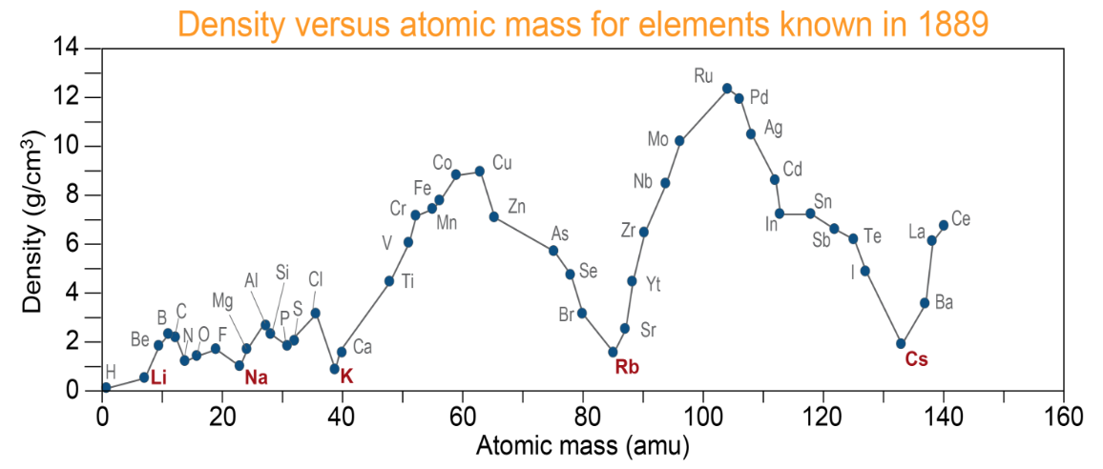
Observations Leading to the Periodic Table
Mendeleev observed repeating patterns in physical properties such as density. When density versus atomic mass in graphed, Mendeleev found that the density of the rose and fell in a repeating cycle.

Slide 6
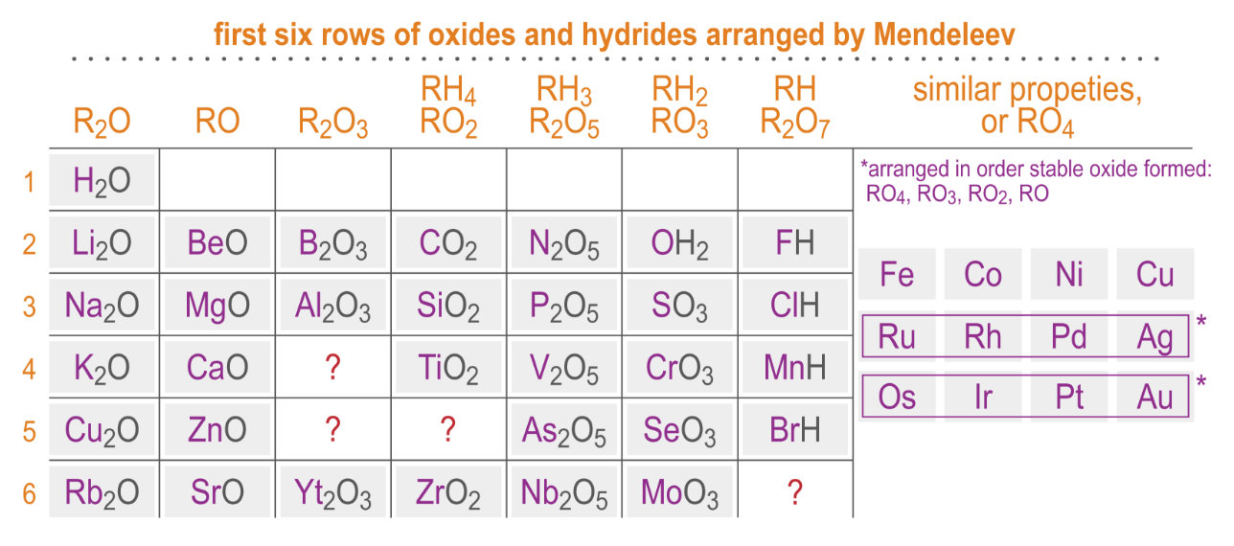
Chemical properties are periodic
When elements are arranged by how they formed compounds with oxygen or hydrogen, another pattern emerged. Look for the patterns in the chemical formulas within each column below.

Slide 7
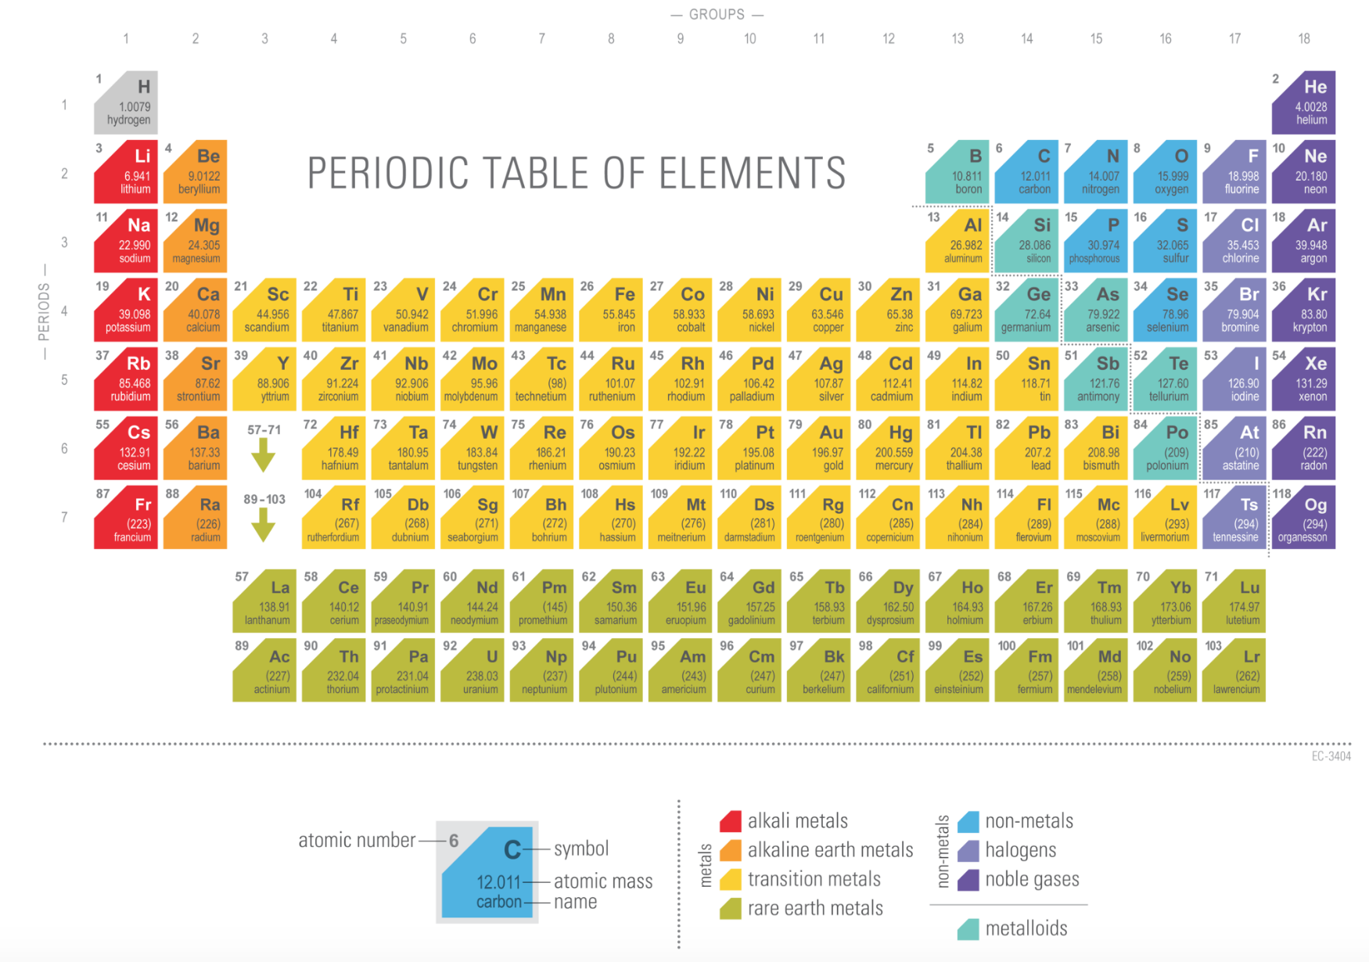
The modern periodic table

Slide 8
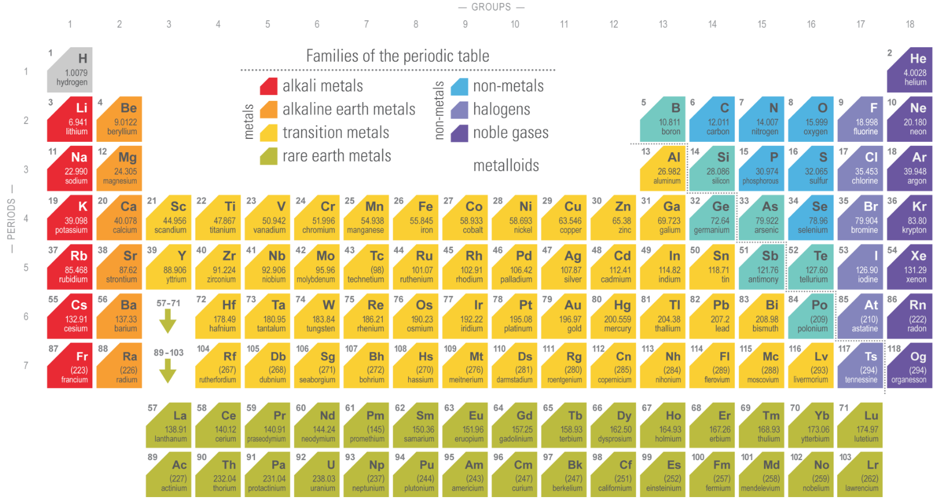
Organization of the periodic table
Elements that share physical and chemical characteristics are placed together in groups.
Each is called a family because family members have similar physical and behavioral traits.

Slide 9
Atoms and elements
Elements are made of atoms which are made of protons, neutrons and electrons.
The smallest particle of any element is one atom.
All atoms of the same element are alike and different from atoms of any other element.
The atomic number is the number of protons (also electrons) in neutral atoms of that element.

Slide 10
The Structure of the Atom

Slide 11
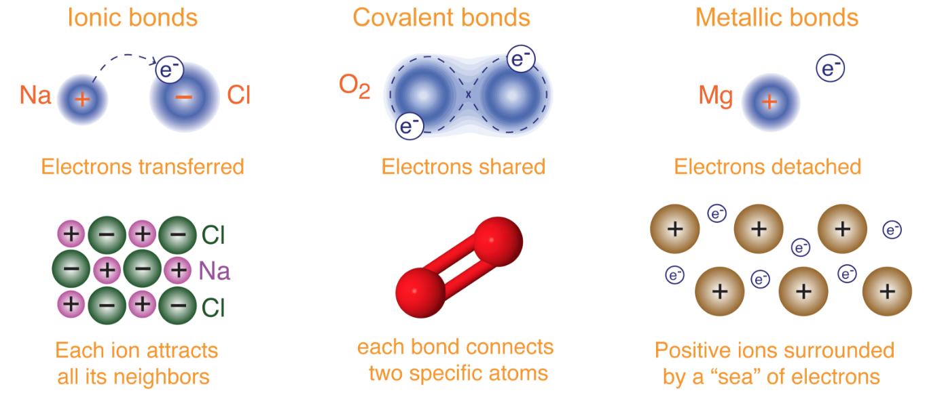
Chemical bonds
There are three characteristic types of chemical bonds though many bonds have varying degrees of electron interaction.

Slide 12
Post-assessment
How is the periodic table organized?

Slide 13
Post-assessment
How is the periodic table organized?
The table is first organized in rows by atomic number then in groups by chemical and physical properties.

Slide 14
Post-assessment
Why is “periodic” an appropriate word to describe the periodic table?

Slide 15
Post-assessment
Why is “periodic” an appropriate word to describe the periodic table?
Periodic means repeating; the properties of elements repeat in a predictable pattern shown on the periodic table.

Slide 16
Post-assessment
What are the parts of an atom, and what particles can be found in each part?

Slide 17
Post-assessment
What are the parts of an atom, and what particles can be found in each part?
The atom has two parts, a tiny nucleus which is surrounded by an electron cloud. Protons and neutrons are in the nucleus and the electron cloud has electrons.

Slide 18
Post-assessment
What is the difference between the 3 types of bonds?

Slide 19
Post-assessment
What is the difference between the 3 types of bonds?
The difference is in how electrons are distributed among atoms in the bonds. Electrons are transferred from one atom to another in an ionic bond, electrons are shared between atoms in a covalent bond, and electrons are shared by all atoms in a metallic bond.

