Slide 1
T = Take Notes
I = Interact with your notes
P = Practice with plenty of repetition
S = Self-test

Slide 2
Chapter 4: Section 3: Electron Configuration

Slide 3
ESSENTIAL QUESTIONS
How does electron arrangement determine atomic properties?
How are valence electrons related to families on the periodic table?
What are electron configurations useful for?
What are the periodic trends in atomic radius, ionic radius and ionization energy?

Slide 4
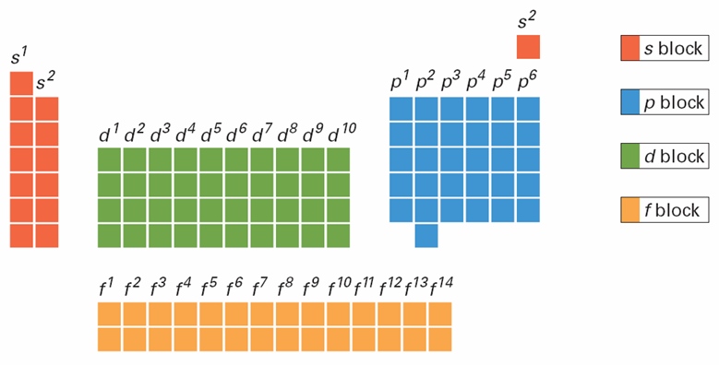
Sublevels
6.2
Blocks of Elements
Notes:
This diagram classifies elements into blocks according to sublevels that are filled or filling with electrons. Interpreting Diagrams In the highest occupied energy level of a halogen atom, how many electrons are in the p sublevel?

Slide 5
Blocks of elements
6.2
Notes:
This diagram classifies elements into blocks according to sublevels that are filled or filling with electrons. Interpreting Diagrams In the highest occupied energy level of a halogen atom, how many electrons are in the p sublevel?

Slide 6
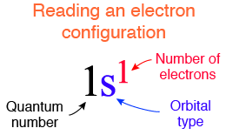
Writing an electron configuration
An electron configuration describes how electrons are distributed among s, p, d, and f orbitals

Slide 7
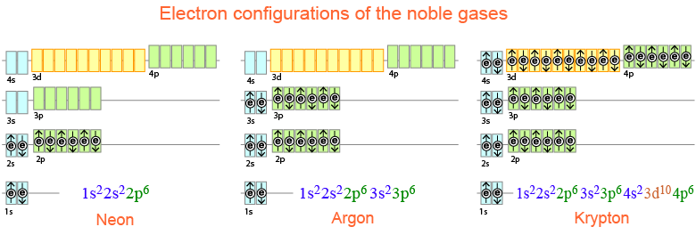
The noble gases
Noble gases have full outermost s and p orbitals
These outermost electrons determine chemical behavior
Electrons in completely filled energy levels are not available to form chemical bonds.
Electrons in unfilled energy levels are available to form chemical bonds.

Slide 8
Group I: Alkali metals
The alkali metals (group 1) all lose an electron easily.
They form +1 ions.
Once they lose an electron they have full energy levels.

Slide 9
Group II metals: Alkaline earth metals
The alkaline earth metals (group 2) all lose an electron2 easily.
They form +2 ions.
Once they lose two electrons they have full energy levels.

Slide 10
The halogens
The halogens (group 17) all gain an electron easily.
They form -1 ions.
Once they gain an electron they have full energy levels.

Slide 11
Carbon, nitrogen, and oxygen
Carbon, nitrogen, and oxygen are among the most important elements to life.
Oxygen and nitrogen both tend to accept electrons, rather than donate them.
Carbon can go either way, sometimes accepting electrons and sometimes donating them.

Slide 12
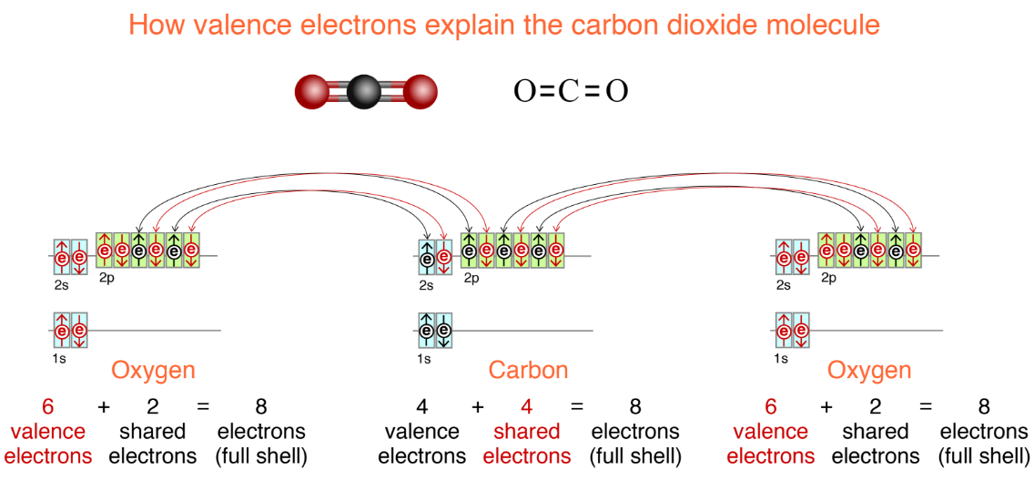
Valence electrons
Electrons that are in highest energy levels are called valence electrons.
Valence electrons participate in chemical bonds

Slide 13
Valence electrons
Valence electrons are lost or gained in ionic bonds and are shared in covalent bonds
Electrons that are in highest energy levels are called valence electrons.
Valence electrons participate in chemical bonds

Slide 14
Solved problem
Determine the number of valence electrons for boron.
Given | The element is boron, atomic number 5
Relationships | The order of filling orbitals is: 1s²2s²2p⁶3s²3p⁶ 4s²3d¹⁰4p⁶ 5s²4d¹⁰5p⁶ 6s²4f¹⁴5d¹⁰6p⁶ Valence electrons are electrons in the highest populated energy level.
Solve | Boron has five electrons, therefore its electron configuration is: 1s²2s²2p¹ The 1s shell is full so does not count towards valence. There are three electrons in the second energy level, which is the highest energy level in boron's configuration.
Answer | Boron has three valence electrons.

Slide 15
Solved problem
Determine the number of valence electrons for phosphorus (P).
Given | The element is phosphorus, atomic number 15
Relationships | The order of filling orbitals is: 1s²2s²2p⁶3s²3p⁶ 4s²3d¹⁰4p⁶ 5s²4d¹⁰5p⁶ 6s²4f¹⁴5d¹⁰6p⁶ Valence electrons are electrons in the highest populated energy level.
Solve | Phorphorus has 15 electrons, therefore its electron configuration is: 1s²2s²2p⁶3s²3p³ The 1s, 2s, and 2p orbitals are full so the first and second energy levels do not count towards valence. There are 5 electrons in the third level.
Answer | Phosphorus has five valence electrons.

Slide 16
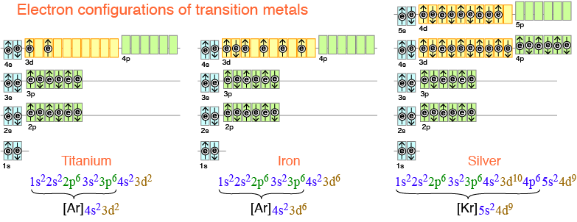
Transition metals
The transition metals are the elements in the middle of the periodic table.
The transition metals all have electrons in d orbitals.

Slide 17
Noble gas core notation
For elements past the 2nd row of the periodic it is tedious to write the entire electron configuration, especially when the real importance is only the valence electrons.
Chemists have a short-hand way to write complex electron configurations using the noble gas core.

Slide 18
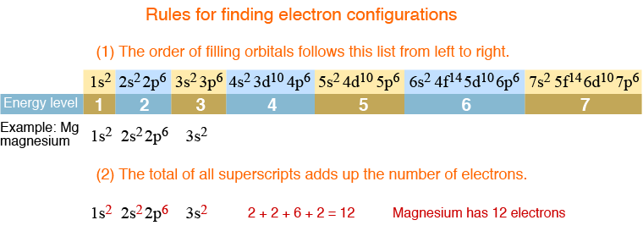
Using electron configurations
Electron configurations are helpful for identifying an element
Configurations are also useful for predicting or explaining a chemical behavior

Slide 19
Solved problem
Name the first three elements that have a p² valence electron configuration. What do all 3 elements have in common?
Given | The problem specifies valence electrons - so these are the highest populated energy level.
Relationships | The order of filling orbitals is: 1s²2s²2p⁶3s²3p⁶ 4s²3d¹⁰4p⁶ 5s²4d¹⁰5p⁶ 6s²4f¹⁴5d¹⁰6p⁶
Solve | The first element with 2p² valence electrons has electron configuration: 1s²2s²2p² or [He]2s²2p² This is carbon, because it has six electrons and an atomic number of six. The next element with 3p² valence electrons has electron configuration: 1s²2s²2p⁶3s²3p² or [Ne]3s²3p² This element has 14 electrons and therefore is silicon. The next element with 4p² valence electrons has electron configuration: 1s²2s²2p⁶3s²3p⁶4s²3d¹⁰4p² or [Ar]4s²3d¹⁰4p² This element has 32 electrons and therefore is germanium.
Answer | The three elements are carbon, silicon, and germanium. All are in group 14 of the periodic table.

Slide 20
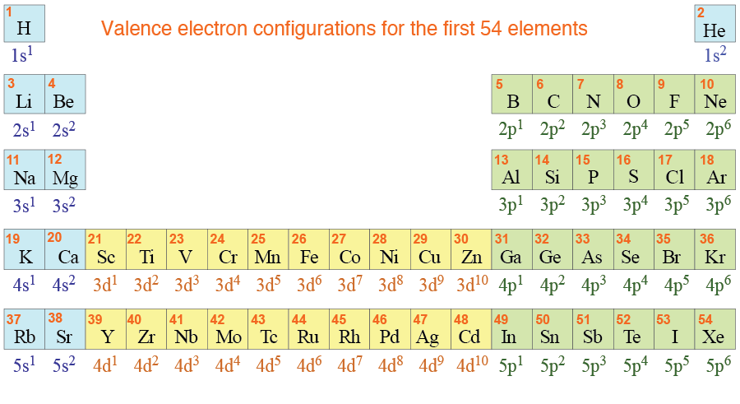
Electron configurations & the periodic table
The repeating pattern in electron configuration explains the repeating pattern in chemical behavior
Elements within the same group (except He) share last-filled orbital configurations

Slide 21
Solved problem
Name two elements that will have similar chemical behavior to calcium (Ca).
Given | Calcium has atomic number 20 and electron configuration: 1s²2s²2p⁶3s²3p⁶4s²
Relationships | Elements with similar valence electrons have similar chemical properties.
Solve | Beryllium has a 2s² valence electron configuration and magnesium has 3s²valence electron configuration. Since both of these elements have the same valence electron configuration they will have similar chemical properties. For example, each combines with oxygen in a 1:1 ratio to make BeO, MgO, and CaO.
Answer | Beryllium and magnesium also have a s² valence electron configuration and will have similar chemical properties to calcium.

Slide 22
Post-assessment
How does electron arrangement determine atomic properties?

Slide 23
Post-assessment
How does electron arrangement determine atomic properties?
Valence electrons determine an element's reactivity; a filled valence is more stable than an unfilled one.

Slide 24
Post-assessment
How are valence electrons related to families on the periodic table?

Slide 25
Post-assessment
How are valence electrons related to families on the periodic table?
Elements within the same family have the same number of valence electrons.

Slide 26
Post-assessment
What are electron configurations useful for?

Slide 27
Post-assessment
What are electron configurations useful for?
Electron configurations can help you identify an element or predict chemical behavior.

