Slide 1
T = Take Notes
I = Interact with your notes
P = Practice with plenty of repetition
S = Self-test

Slide 2
Chapter 4: Section 1: Electromagnetic spectrum

Slide 3
ESSENTIAL QUESTIONS
How does electron arrangement determine atomic properties?
How are valence electrons related to families on the periodic table?
What are electron configurations useful for?
What are the periodic trends in atomic radius, ionic radius and ionization energy?

Slide 4
Light and Atoms

Slide 5
Development of atomic models
What was inadequate about Rutherford’s atomic model?
Rutherford’s atomic model could not explain the chemical properties of elements
Rutherford’s atomic model could not explain why objects change color when heated.

Slide 6
Development of atomic models
According to the wave model, light consists of electromagnetic waves.
Electromagnetic radiation includes radio waves, microwaves, infrared waves, visible light, ultraviolet waves, X-rays, and gamma rays.
All electromagnetic waves travel in a vacuum at a speed of
2.998 × 10⁸ m/s or 3.00 x 10⁸

Slide 7
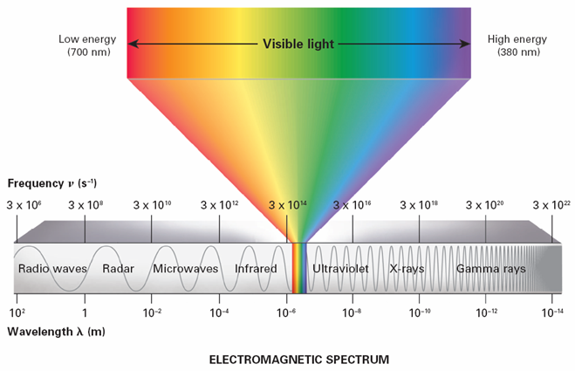
electromagnetic spectrum
The electromagnetic spectrum consists of radiation over a broad band of wavelengths.

Slide 8
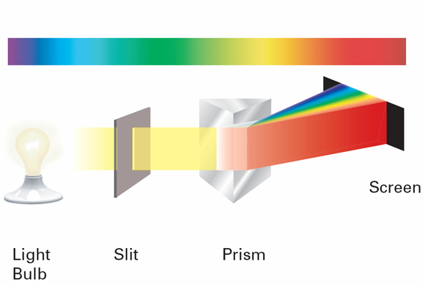
Emmision spectrum
A prism separates light into the colors it contains. When white light passes through a prism, it produces a rainbow of colors.

Slide 9
Bohr model
What was the new proposal in the Bohr model of the atom?
Bohr proposed that an electron is found only in specific circular paths, or orbits, around the nucleus.
Each possible electron orbit in Bohr’s model has a fixed energy.
The fixed energies an electron can have are called energy levels.
A quantum of energy is the amount of energy required to move an electron from one energy level to another energy level.

Slide 10
Atomic emission spectra
What causes atomic emission spectra?
When atoms absorb energy, electrons move into higher energy levels. These electrons then lose energy by emitting light when they return to lower energy levels.

Slide 11
Post-assessment
How is the atomic emission spectrum produced.

Slide 12
Post-assessment
How is the atomic emission spectrum produced?
Electrons get excited, absorb energy to jump above its shell, goes right back down to release energy in the from of light.

Slide 13
Post-assessment
What are electron configurations useful for?

Slide 14
Post-assessment
What are electron configurations useful for?
Electron configurations can help you identify an element or predict chemical behavior.

