Slide 1
T = Take Notes
I = Interact with your notes
P = Practice with plenty of repetition
S = Self=test

Slide 2
Chapter 4 Section 2: The Quantum Model of the Atom

Slide 3
ESSENTIAL QUESTIONS
What is a “quantum” of energy?
What is a photon?
How is an electron related to a photon?
What are some examples of energy rules electrons within electron clouds obey?
What causes spectral lines?
Why are spectral lines considered evidence of energy levels within an atom’s electron cloud?

Slide 4
Quantum theory and chemistry
Atoms interact with other atoms through electrons. Interactions such as forming chemical bonds occur through electrons.
When electrons are confined in an atom, their wave properties force them into specific patterns called quantum states that minimize the total energy of the atom.

Slide 5
The early evidence
In 1870, English scientist William Crookes created a sealed glass tube and pumped out virtually all of the air inside.
Englishman, J.J. Thomson, devised a series of experiments that showed cathode rays were deflected by magnets and were also deflected toward a positively charged plate, and away from a negative plate.

Slide 6
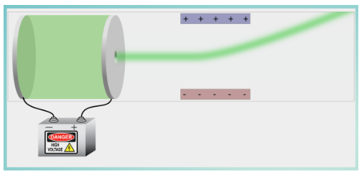
Interactive
Re-create Thomson's experiment in the interactive simulation titled Thomson's Discovery. Experiment with different atoms and plate charges.

Slide 7
Radioactivity
In 1898, French scientists Marie and Pierre Curie discovered that uranium spontaneously emitted some form of energy that they named radioactivity.
In 1899, Ernest Rutherford's team identified two forms of energy emitted by uranium, which he named alpha and beta.

Slide 8
The gold foil experiment
A stream of high speed alpha particles was shot at a thin gold foil.
Alpha particles were detected at different angles after passing through the foil.
Most of the alpha particles passed through completely unaffected, as if they had somehow completely missed every atom.
Very few alpha particles bounced off at large angles and about 1 in 20,000 even bounced backward!

Slide 9
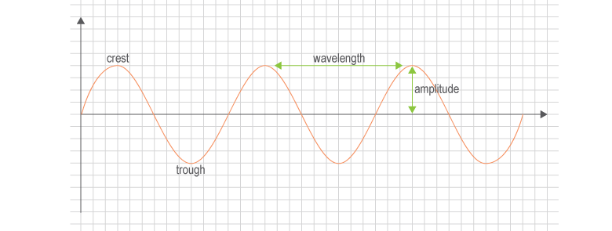
What is a wave
The highest point of a wave is called the crest and the lowest is called the trough.
The distance from one crest to another is called the wavelength.
The amplitude of a wave is measured as half the distance from the crest to the trough.

Slide 10
Wave equations
The relationship between wavelength and frequency is illustrated by the equation;
c = λν
Wavelength is the Greek letter lambda, λ and frequency is the letter nu, ν.
The energy of a wave (E) is calculated by multiplying the frequency of the wave by a constant called Plank’s constant (h).
E = hν

Slide 11
Solved problem
What is the energy of an orange light that has a wavelength of 640. nm?
Given | λ = 640. nm or 6.40 x 10⁻⁷ m
Relationships | c = λν; E = hν ; c = 2.998 x 10⁸ m/s; h = 6.626 x 10⁻³⁴ J·s
Solve | First use the equation c = λν to find frequency 2.998 x 10⁸ m/s = 6.40 x 10⁻⁷m × ν Then use the equation E = hν to find energy.
Answer | An orange light has 3.10 x 10⁻¹⁹ J of energy.

Slide 12
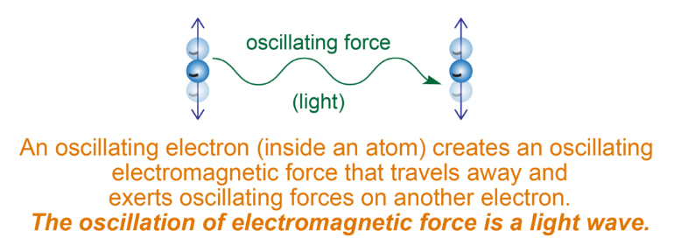
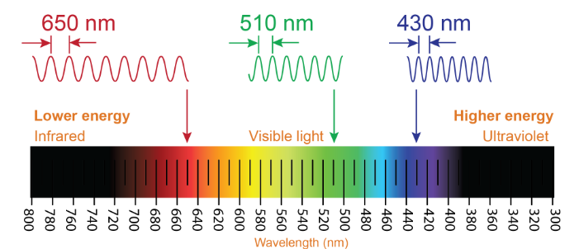
Light and atoms
Virtually all visible light comes from the oscillations of electrons in atoms.

Slide 13
The puzzle of spectral lines
When electricity is passed through hydrogen gas, the gas glows and gives off very specific colors and nothing in between.
Johann Balmer discovered that the colors of light in the obeyed a precise mathematical relationship, named Balmer’s formula in his honor.

Slide 14
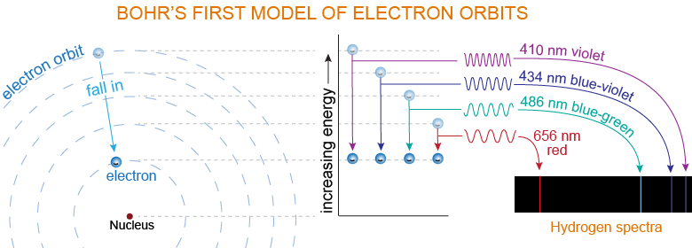
The Bohr model of the atom
Danish physicist Niels Bohr deduced a brilliant explanation for Balmer’s formula.
Bohr proposed that the electron makes circular orbits around the nucleus.

Slide 15
The uncertainty principle
Heisenberg's uncertainty principle says that there is a limit to how accurately you can either know where an electron is, or its direction and velocity.

Slide 16
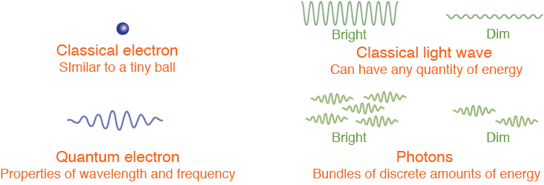
The wave/particle model
The word "quanta" means a discrete unit that cannot be subdivided.
The quantum theory of light states that light is a stream of tiny discrete energy bundles.
Each energy bundle is one photon.
The quantum theory of light is very different from the wave theory.

Slide 17
Electron waves in atoms
When Schrödinger's equation was applied to an electron bound to a proton, an amazing discovery was made.
The electron wave forms a sequence of three-dimensional "standing wave" patterns
Each pattern corresponded to a specific energy for an electron
The differences in energy between one pattern and another were exactly equal to the photon energies of the spectral lines in hydrogen

Slide 18
Quantum states
Each unique standing wave pattern is called a quantum state.
The probability of finding an electron in a quantum state is virtually 100%.
Electrons in atoms are either in a quantum state or moving from one state to another.

Slide 19
The s, p, d, and f orbitals
The wave patterns or orbitals are named s, p, d, and f.
The "s" orbital is spherically symmetric around the nucleus and can hold 2 electrons.
The "p" orbital has 3 sub-orbitals aligned with 3 coordinate axes. Each suborbital can hold 2 electrons for a total of 6.
The "d" orbital has a more complex shape and can hold a maximum of 10 electrons. The "f" orbitals can hold 14 electrons.

Slide 20
Energy levels
An energy level is a group of orbitals that have similar energy.
The Aufbau principle states that electrons fill the lowest energy orbitals before higher energy orbitals.

Slide 21
Rules for writing electron configuration
The ways in which electrons are arranged in various orbitals around the nuclei of atoms are called electron configurations.
Three rule:
The aufbau principle
The Pauli exclusion principle
TheHund’s rule

Slide 22
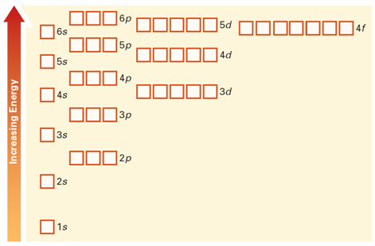
Aufbau principle
According to the aufbau principle, electrons occupy the orbitals of lowest energy first. In the aufbau diagram below, each box represents an atomic orbital.

Slide 23
Pauli exclusion principle
The Pauli exclusion principle states that no two electrons in the same atom can be in the same quantum state at the same time.
Spin is a quantum property than can have only two values: +1/2 and -1/2.
Each orbital (or sub-orbital) can hold two electrons
They do not have the exact same quantum state: one electron is spin +1/2 and the other is spin -1/2.

Slide 24
Hund’s rule
Hund's Rule states that electrons fill orbitals separately before doubling up.

Slide 25
Ground and excited states
The ground state is the lowest energy configuration of an atoms.
An excited state occurs when one or more electrons occupies an orbital higher than the ground state.

Slide 26
Emission and absorption of light
Any atom may go from the ground state to an excited state by absorbing energy.
An atom may ONLY absorb a photon of light IF the photon matches the energy difference between two energy levels AND the higher energy level is unoccupied.

Slide 27
Spectroscopy
A spectrum shows the individual colors that correspond to the energy transitions between energy levels.
Spectroscopy is the study of spectra for research and technology.
An instrument that disperses light into its constituent wavelengths is called a spectrometer.

Slide 28
Post-assessment
What is a “quantum” of energy?

Slide 29
Post-assessment
What is a “quantum” of energy?
A quantum is the smallest "bit" or amount of energy possible.

Slide 30
Post-assessment
What is a photon?

Slide 31
Post-assessment
What is a photon?
A photon is a quantum of light.

Slide 32
Post-assessment
How is an electron related to a photon?

Slide 33
Post-assessment
How is an electron related to a photon?
Both are particles, both act like waves. Electrons can emit photons when they return from excited state to ground state, but photons cannot emit electrons.

Slide 34
Post-assessment
What are some examples of energy rules electrons within electron clouds obey?

Slide 35
Post-assessment
What are some examples of energy rules electrons within electron clouds obey?
Electrons fill the lowest energy level first; no 2 electrons can be in the same place at the same time; orbitals can only hold 2 electrons but electrons fill orbitals singly before they pair up.

Slide 36
Post-assessment
What causes spectral lines?

Slide 37
Post-assessment
What causes spectral lines?
When an electron absorbs enough energy to go to an excited state, the electron releases a photon of light when it returns to ground state. Spectral lines are the visible energies of released photons.

Slide 38
Post-assessment
Why are spectral lines considered evidence of energy levels within an atom’s electron cloud?

Slide 39
Post-assessment
Why are spectral lines considered evidence of energy levels within an atom’s electron cloud?
Spectral lines only appear if the minimum energy is absorbed by electrons, and the released photons themselves have specific energy that relates to the quantum structure.

