Slide 1
T = Take Notes
I = Interact with your notes
P = Practice with plenty of repetition
S = Self-test

Slide 2
Chapter 3: Section 1:The Atom

Slide 3
Essential questions
How big is an atom?
What are some ways elements are organized on the periodic table?

Slide 4
The question of scale
In the scientific context, scale means a typical level or unit of measure that shows a particular amount of detail.
Observations are on the macroscopic scale when they are large enough for us to see or directly measure in an experiment.
Matter as small as atoms is at the atomic scale. In chemistry we traditionally will refer to the atomic scale as the microscopic scale even though this differs from how biologists would use the term.

Slide 5
Early models of the atom
An atom is the smallest particle of an element that retains its identity in a chemical reaction.
Philosophers and scientists have proposed many ideas on the structure of atoms.

Slide 6
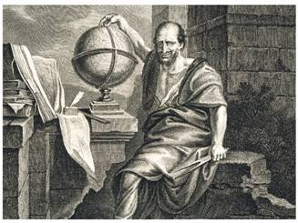
Atomic theories
Democritus’s Atomic Philosophy
How did Democritus describe atoms?
Democritus believed that atoms were indivisible and indestructible.
Democritus’s ideas were limited because they didn’t explain chemical behavior and they lacked experimental support.

Slide 7
Atomic theories
Dalton’s Atomic Theory
How did John Dalton further Democritus’s ideas on atoms?
By using experimental methods, Dalton transformed Democritus’s ideas on atoms into a scientific theory.
The result was Dalton’s atomic theory.

Slide 8
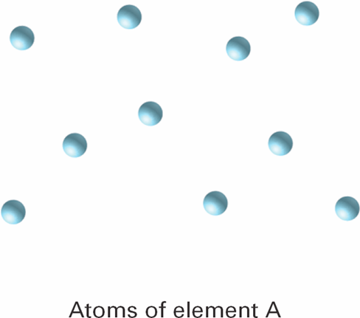
Dalton’s atomic theories (1)
1. All elements are composed of tiny indivisible particles called atoms.

Slide 9
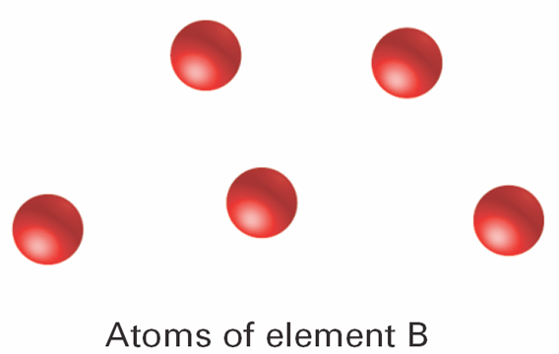
(2)
2. Atoms of the same element are identical. The atoms of any one element are different from those of any other element.

Slide 10
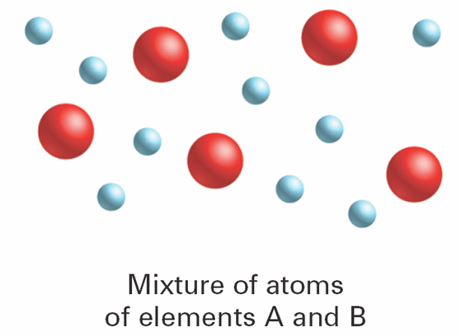
(3)
3. Atoms of different elements can physically mix together or can chemically combine in simple whole-number ratios to form compounds.

Slide 11
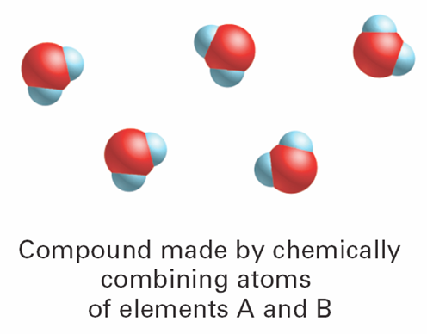
(4)
4. Chemical reactions occur when atoms are separated, joined, or rearranged. Atoms of one element are never changed into atoms of another element in a chemical reaction.

Slide 12
Solved problem
4. Chemical reactions occur when atoms are separated, joined, or rearranged. Atoms of one element are never changed into atoms of another element in a chemical reaction.

Slide 13
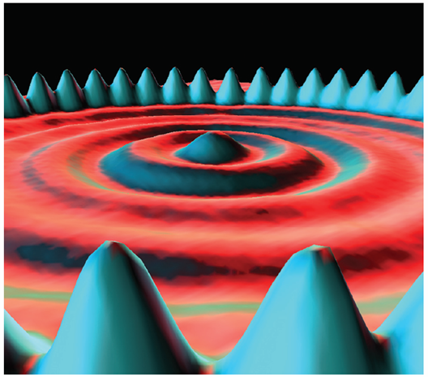
Scanning tunneling microscope
Despite their small size, individual atoms are observable with instruments such as scanning tunneling microscopes.

Slide 14
Post-assessment
What is the difference between the macro and micro scale?

Slide 15
Post-assessment
What is the difference between the macro and micro scale?
The macroscopic scale is visible without any special tools needed. The microscopic scale is too small to see.

Slide 16
Post-assessment
How big is an atom?

Slide 17
Post-assessment
How big is an atom?
Atoms are on the microscopic scale, but far smaller than microorganisms like bacteria.

