Slide 1
T = Take Notes
I = Interact with your notes
P = Practice with plenty of repetition
S = Self-test

Slide 2
Chapter 2: Section 2: Density

Slide 3
Essential questions
How do changes in mass and volume affect density?
What does it mean to be “conserved”?
Why is it important be aware of the law of conservation of energy when studying chemistry?

Slide 4
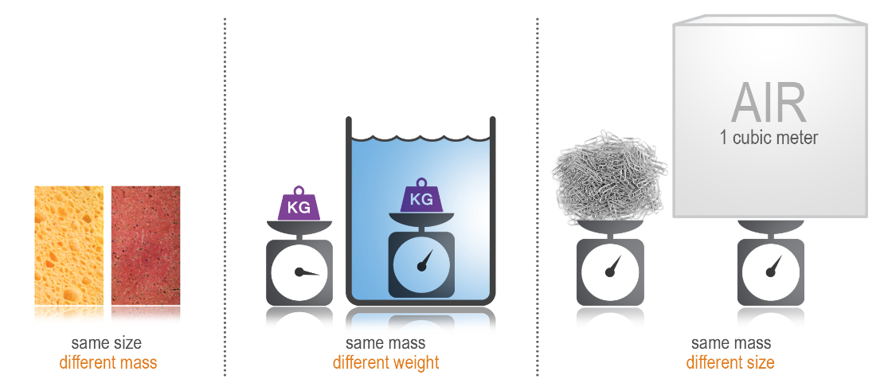
Mass and weight
Mass is a measure of how much matter is in an object.
Mass uses the units, kilogram (kg) and gram (g).
Mass is acted upon by gravity and it is convenient to use an object's weight to measure mass. Weight is the force of gravity acting on mass.

Slide 5
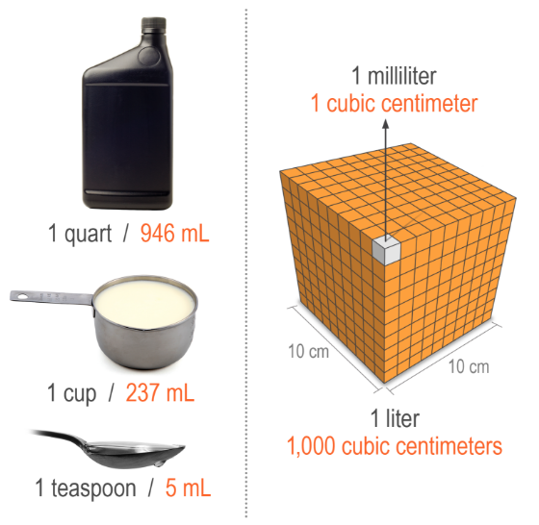
Volume
Volume is an amount of space having length, width and height.
Measurements of volume are in the liter (L) or milliliter (mL).

Slide 6
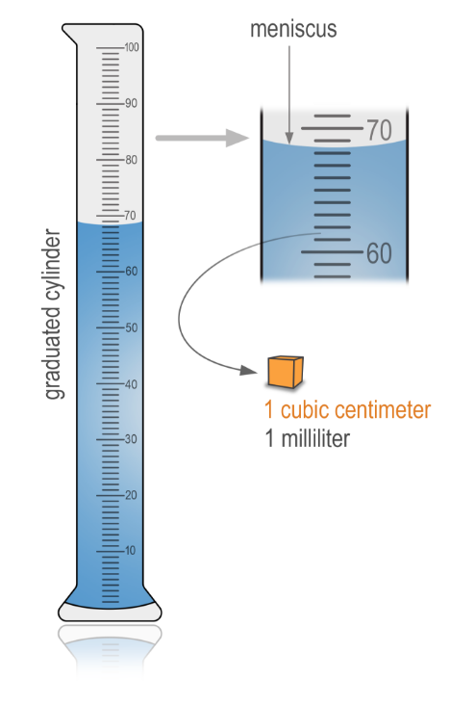
Measuring volume with a graduated cylinder
The graduated cylinder is a tool for measuring the volume of liquids.
Water adheres slightly to glass and plastic, so the surface creeps up around the edges. This shape is called a meniscus. Graduated cylinders are read from the lowest point of the meniscus.

Slide 7
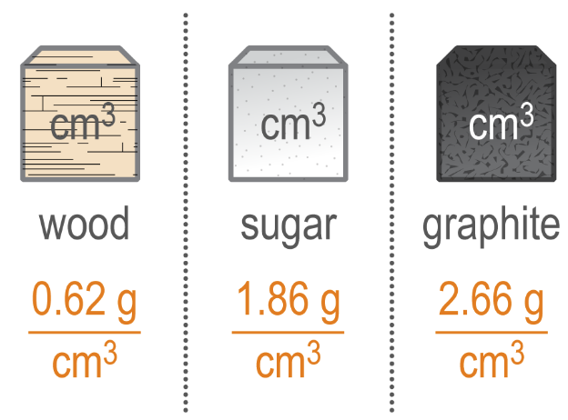
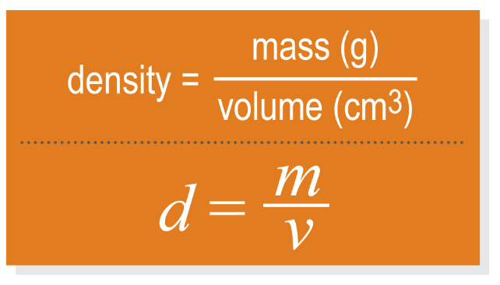
Density
Density describes how much mass is in a given volume of a material.
Density is a property of matter, independent of size or shape.
Density is mass per unit volume.

Slide 8
Forms of Energy
Energy measures the capacity for change.
Mechanical energy comes from position or motion.
Pressure is a form of mechanical energy
Radiant energy comes from electromagnetic waves such as visible light, microwaves, radio waves, x-rays.
Nuclear energy comes from within atoms.
Electrical energy comes from a flowing electric current

Slide 9
Energy
The fundamental unit of energy is the joule.
Energy can change from one form to another.

Slide 10
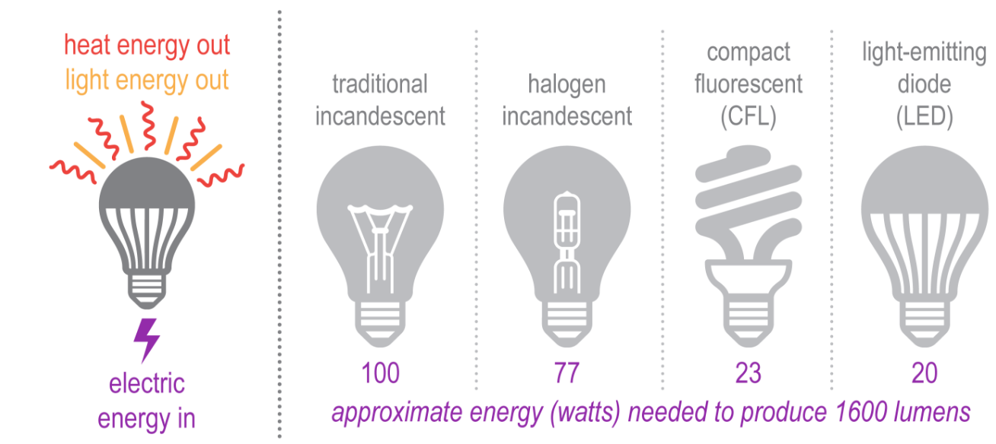
Conserving energy
In scientific context when a quantity is conserved that means the total amount of the quantity does not change over time.
An electric light bulb converts electrical energy to light. The bulb doesn't really "use-up" energy. Every joule of electrical energy becomes light or heat.

Slide 11
Post-assessment
Why do we use SI units to measure matter and energy?

Slide 12
Post-assessment
Why do we use SI units to measure matter and energy?
SI units are easy to convert and easier to communicate if everyone uses the same measurement system.

Slide 13
Post-assessment
How do changes in mass and volume affect density?

Slide 14
Post-assessment
How do changes in mass and volume affect density?
If either mass or volume changes, the density will change, unless mass and volume both change in way that does not affect the ratio of one quantity to the other. For example if both mass and volume double, density won't change because the ratio remains the same but if only volume doubles and mass does not, then the mass-to-volume ratio and thus density will change.

Slide 15
Post-assessment
What does it mean to be “conserved”?

Slide 16
Post-assessment
What does it mean to be “conserved”?
If something is conserved that means the total amount remains the same.

Slide 17
Post-assessment
Why is it important be aware of the law of conservation of energy when studying chemistry?

Slide 18
Post-assessment
Why is it important be aware of the law of conservation of energy when studying chemistry?
An important part of chemistry is the study of changes in matter. We need to keep track of how energy changes when matter changes.

