Slide 1
T = Take Notes
I = Interact with your notes
P = Practice with plenty of repetition
S = Self-test

Slide 2
Chapter 18:
Equilibrium

Slide 3
Pre-assessment
What stays the same during chemical equilibrium?
What changes during chemical equilibrium?
What symbol is used to indicate a reaction is in chemical equilibrium?
What does the equilibrium position tell you about products?
What is an equilibrium constant used for?
How can you predict how much product will be formed in an equilibrium reaction?

Slide 4
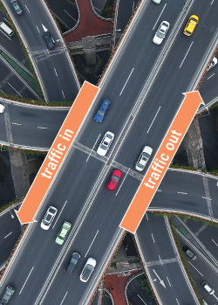
Reversibility of chemical reactions
Reactions that are capable of going back and forth achieve a balance between the rate of the forward and reverse direction.
This balance is known as equilibrium.
The amount of product and reactant remains constant over time, but the elements are continuously exchanged like the cars in and out of the city.

Slide 5
Chemical equilibrium
The two data lines indicate there are two different chemicals changing amounts then coming to some kind of balance
The graph on the left shows concentrations are not equal, however, you can see concentration has leveled off and is not changing over time
The graph on the right shows that although the rates of the two chemicals did not start out the same, they eventually found a rate equal to one another

Slide 6
Chemical equilibrium in the air
The N₂O₄(g) ⇌ 2NO₂(g) equilibrium reaction:
From the graph on the left, you can see that in the beginning there is only the product, N₂O₄. At equilibrium, the concentrations became steady and the rates of the forward and reverse reaction are equal.

Slide 7
Equilibrium position
The equilibrium position indicates whether the products or reactants are favored at equilibrium.
Once equilibrium is established, the side of the reaction with the highest concentration is favored

Slide 8
What is an equilibrium expression?
The equilibrium expression is set up by dividing the concentration of the products by the concentration of the reactants. The coefficients of the balanced equation become exponents.
Once equilibrium is established, the products and reactants have a set ratio. This ratio is known as the equilibrium constant.

Slide 9
Creating the equilibrium expression
The equation, A + 2B ⇌ C + 4D can be written as A + B + B ⇌ C + D + D + D + D
The equilibrium expression is:
Notice how the expanded version and the simplified version of the expression are the same.

Slide 10
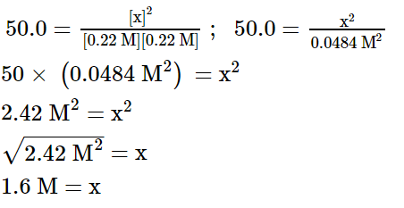
Solved problem
Calculate the equilibrium concentration of [HI] given the following information. H₂(g) + I₂(g) ⇌ 2HI(g), K = 50.0 at 450 °C. The equilibrium concentrations of the reactants are [H₂] = 0.22 M and [I₂]= 0.22 M.
Given: | K = 50.0 at 450 °C, and [H₂] = [I₂] = 0.22 M
Relationships: | Equilibrium expression: When known quantities are placed into the expression they do not have to be multiplied by the coefficient because they are at equilibrium and in the correct ratio.
Solve: | Substitute given values into the expression and solve for x:
Answer: | The equilibrium concentration of [HI] = 1.6 M

Slide 11
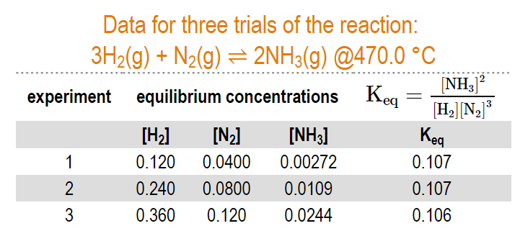
K_{eq} is constant
When the measured equilibrium concentrations are plugged into the equilibrium expression, the calculated K_{eq} is the same for all trials.

Slide 12
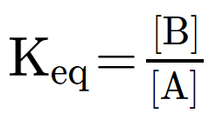
Using the equilibrium constant
Using the simple reaction A(g) ⇌ B(g) the equilibrium expression is:
When K_{eq} is very large (K_{eq} > 10⁴), [B] must be much larger than [A] and the products are favored for this reaction.
When K_{eq} is very small (K_{eq} < 10⁻⁴), [A] must be much larger than [B] and the reactants are favored for this reaction.

Slide 13
Solved problem
The reaction N₂+3H₂ ⇌ 2NH₃ has a K_{eq} of 3.55 x 10⁻² at 500 K and 7.76 x 10⁻⁵ at 700K. Which temperature will make the most products?
Given: | 3.55 x 10⁻² at 500 K and 7.76 x 10⁻⁵ at 700 K
Relationships:
Solve: | Since the equilibrium expression is a ratio of products to reactants, the largest K_{eq} will produce the most products. 3.55 x 10⁻² is larger than 7.76 x 10⁻⁵ and will make more products.
Answer: | 500 K will make more products.

Slide 14
Post-assessment
What stays the same during chemical equilibrium?

Slide 15
Post-assessment
What stays the same during chemical equilibrium?
The rate at which reactants form products and products form reactants stays the same during equilibrium.

Slide 16
Post-assessment
What changes during chemical equilibrium?

Slide 17
Post-assessment
What changes during chemical equilibrium?
New products are formed from reactants and new reactants are formed from products during equilibrium.

Slide 18
Post-assessment
What symbol is used to indicate a reaction is in chemical equilibrium?

Slide 19
Post-assessment
What symbol is used to indicate a reaction is in chemical equilibrium?
This is the symbol for chemical equilibrium: ⇌

Slide 20
Post-assessment
What does the equilibrium position tell you about products?

Slide 21
Post-assessment
What does the equilibrium position tell you about products?
The equilibrium position tells you whether products will be favored or not.

Slide 22
Post-assessment
What is an equilibrium constant used for?

Slide 23
Post-assessment
What is an equilibrium constant used for?
The equilibrium constant is used to help chemists predict ways to make a reversible reaction favor production of either a product or reactant of interest.

Slide 24
Post-assessment
How can you predict how much product will be formed for an equilibrium reaction?

Slide 25
Post-assessment
How can you predict how much product will be formed for an equilibrium reaction?
The equilibrium expression can be used to predict the concentration of a substance of interest.

