Slide 1
T = Take Notes
I = Interact with your notes
P = Practice with plenty of repetition
S = Self-test

Slide 2
Chapter 11: Section 2: The Gas Laws

Slide 3
Essential questipons
How are gas pressure and volume related when temperature is held constant?
How are gas volume and temperature related when pressure is held constant?
According to Avogadro's law, how are moles of a gas and its volume related when temperature and pressure are constant?

Slide 4
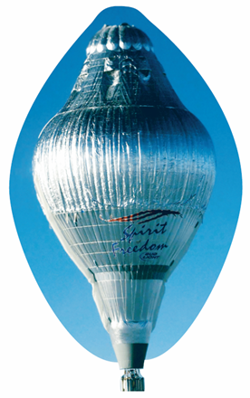
The Gas Laws
This hot air balloon was designed to carry a passenger around the world. You will study some laws that will allow you to predict gas behavior under specific conditions, such as in a hot air balloon.

Slide 5
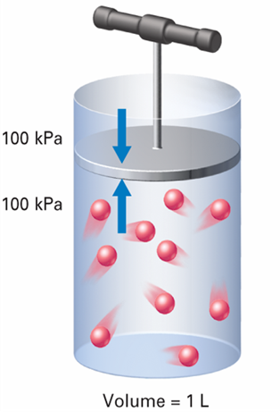
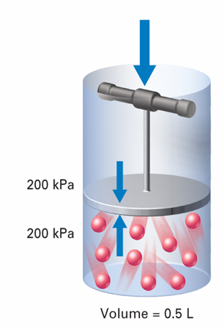
Boyle’s Law: Pressure and Volume
Boyle’s Law: Pressure and Volume
How are the pressure, volume, and temperature of a gas related?
If the temperature is constant, as the pressure of a gas increases, the volume decreases.

Slide 6
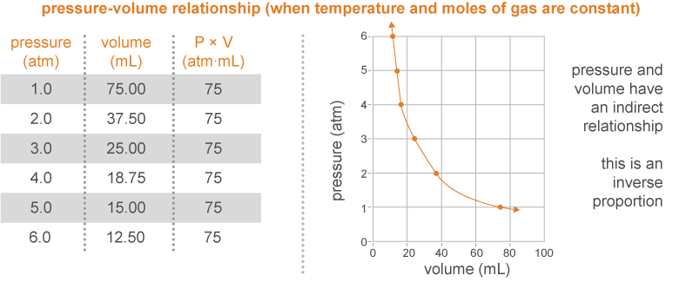
Volume and pressure of a gas: Boyle’s law
Boyle's Law states that pressure is inversely proportional to volume and is expressed as;
P × V = a constant

Slide 7
Boyle’s Law: Pressure and Volume
Boyle’s law states that for a given mass of gas at constant temperature, the volume of the gas varies inversely with pressure.

Slide 8
Using Boyle’s law
Boyle's Law states that when temperature is not changing, pressure is inversely proportional to volume and is expressed as P × V = a constant.
Notice that an increase in container volume results in a lower pressure.

Slide 9
Solved problem
If a sealed bag of chips increases its volume from 725 mL to 815 mL on a drive from the beach to a mountain, what is the new pressure inside the bag?
Asked | What is the new volume (V₂) of the balloon when it reaches 100,000 ft?
Given | P₁ = 1.00 atm; V₁ = 725 mL; V₂ = 815 mL
Relationships | P₁V₁ = P₂V₂
Solve
Answer | The bag pressure will decrease to 0.890 atm.

Slide 10
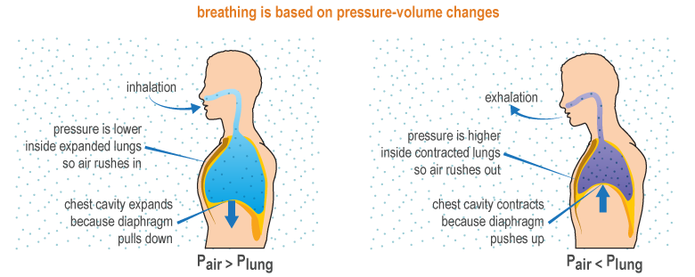
Pressure in daily life
There is no such thing as “suction”
What seems like “suction” is not a pull force; it is an extra push force that is created when there is a pressure imbalance
“Suction” stops working when pressure is balanced… no imbalance, no extra push

Slide 11
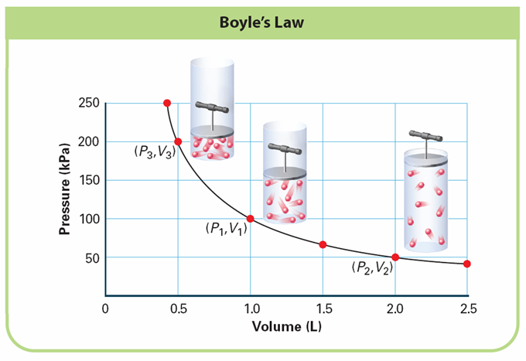
Notes:
The pressure of a gas changes as the volume changes. INTERPRETING GRAPHS a. Observing When the volume is 2.0 L, what is the pressure? b. Predicting What would the pressure be if the volume were increased to 3.0 L? c. Drawing Conclusions Based on the shape of the graph, describe the general pressure-volume relationship.

Slide 12
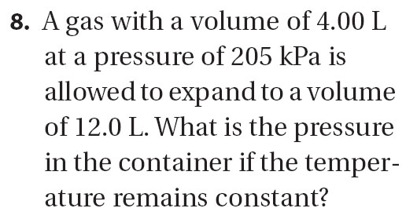

Slide 13
Charles’s Law: Temperature and Volume
Charles’s Law: Temperature and Volume
As the temperature of an enclosed gas increases, the volume increases, if the pressure is constant.

Slide 14
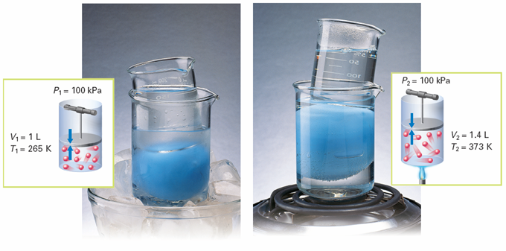
Charles’s Law: Temperature and Volume
As the temperature of the water increases, the volume of the balloon increases.
Notes:
When the gas in the blue balloon is cooled at constant pressure, the volume of the gas decreases. When the gas is heated at constant pressure, the volume increases. Calculating What is the ratio of volume to temperature for each set of conditions? Round your answer to two significant figures.

Slide 15
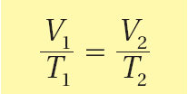
Charles’s Law: Temperature and Volume
Charles’s law states that the volume of a fixed mass of gas is directly proportional to its Kelvin temperature if the pressure is kept constant.

Slide 16
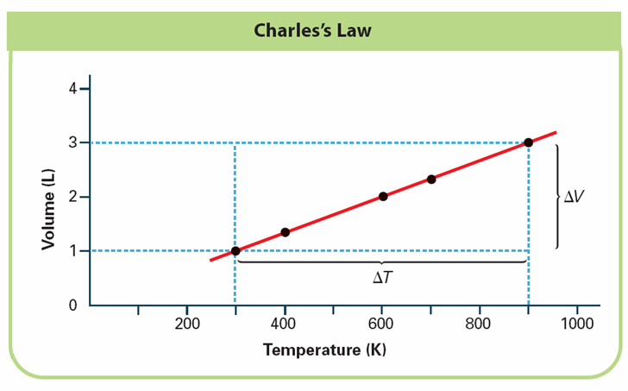
Notes:
This graph shows how the volume changes as the temperature of a gas changes. INTERPRETING GRAPHS a. Observing What is the unit of temperature? b. Drawing Conclusions What happens to the volume as the temperature rises? c. Predicting If the temperature of a gas were 0 K, what would the volume of the gas be?

Slide 17
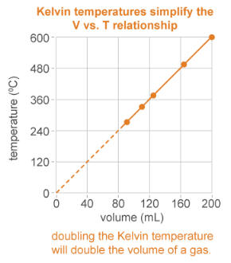
Creating a new temperature scale
As temperature decreases, so does volume
Lord Kelvin realized that if you extend the line to zero volume, you would reach the lowest possible temperature
−273 °C is this lowest temperature, known as absolute zero
No negative temperatures are possible on the Kelvin scale

Slide 18
Charles’ law
Charles law states that at an unchanging pressure, volume is directly proportional to temperature, and can be expressed as V/T = a constant.

Slide 19
Solved problem
How small will a 5.0 L balloon become when you take it from your classroom, where the temperature is 22.1 °C, to the cafeteria freezer where it is -18.0 °C?
Asked | What is the new balloon volume (V₂) when the temperature drops to -18.0 °C?
Given | V₁ = 5.0 L, T₁ = 22.1 °C, T₂ = -18.0 °C
Relationships | Kelvin temperature conversion, K = °C + 273 $$\text{Charles}\text{′ }\text{Law}\text{ = }\frac{{\text{V}}_{\text{1}}}{{\text{T}}_{\text{1}}}\text{=}\frac{{\text{V}}_{\text{2}}}{{\text{T}}_{\text{2}}}$$
Solve | First, Convert temperatures from °C to K: T₁ in Kelvin: 22.1 °C + 273=295.1 K T₂ in Kelvin: -18.0 °C + 273 =255K Next, enter quantities into the equation
Answer | The partial pressure of hydrogen gas is 98.156 kPa.

Slide 20
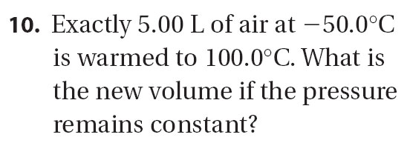

Slide 21
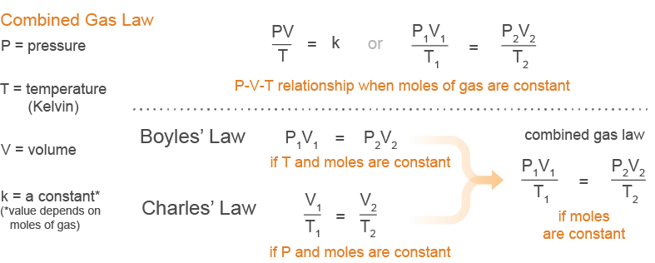
Combining Boyle’s law and Charles’ law
The combined gas law puts Boyle’s law and Charles’ law together to allow pressure, volume, and temperature to vary.

Slide 22
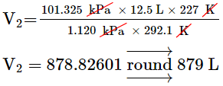
Solved problem
Meteorologists use weather balloons to measure atmospheric conditions up to 100,000 feet above sea level where pressure equals 1.120 kPa and temperature is about -46.0 °C. A weather balloon with 12.5 L of helium gas is at sea level where the pressure is 101.325 kPa and the temperature is 19.1 °C. How big will the balloon be when it reaches 100,000 feet?
Asked | What is the balloon’s new volume (V₂) when it reaches 100,000 feet?
Given | P₁=1.00 atms; V₁=18.0 m³; T₁=20.0 °C; P₂=0.0100 atm; T₂=-50.0 °C
Relationships | Kelvin conversion, K = °C + 273, and the combined gas law, or rewritten as: P₁ V₁ T₂ = P₂ V₂ T₁
Solve | When converted to Kelvin, T₁ = 292.1 K and T₂ = 227 K 101.325 kPa × 12.5 L × 227 K = 1.120 kPa × V₂ × 292.1 K
Answer | The balloon’s new volume at 100,000 feet is 1,370 m³.

Slide 23
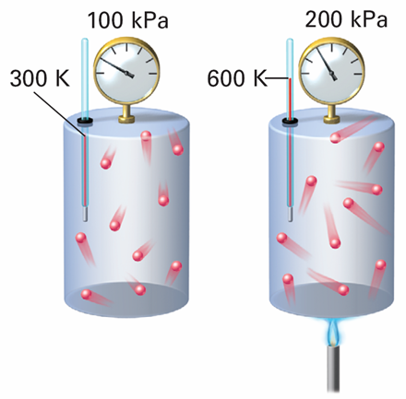
Gay-Lussac’s Law: Pressure and Temperature
Gay-Lussac’s Law: Pressure and Temperature
As the temperature of an enclosed gas increases, the pressure increases, if the volume is constant.

Slide 24
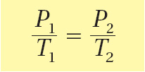
Gay-Lussac’s Law: Pressure and Temperature
Gay-Lussac’s law states that the pressure of a gas is directly proportional to the Kelvin temperature if the volume remains constant.

Slide 25
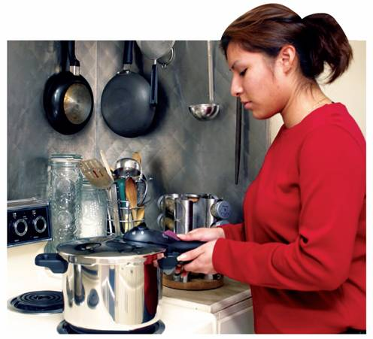
Gay-Lussac’s Law: Pressure and Temperature
A pressure cooker demonstrates Gay-Lussac’s Law.
Notes:
In a pressure cooker, food cooks faster than in an ordinary pot with a lid.

Slide 27
The Combined Gas Law
When is the combined gas law used to solve problems?
The combined gas law describes the relationship among the pressure, temperature, and volume of an enclosed gas.

Slide 28
The Combined Gas Law
The combined gas law allows you to do calculations for situations in which only the amount of gas is constant.

Slide 29
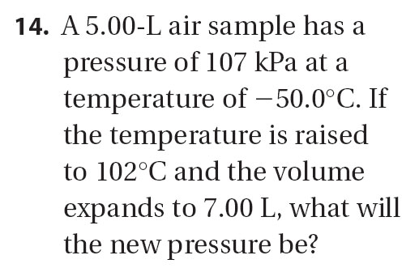

Slide 30
Post-assessment
How are gas pressure and volume related when temperature is held constant?

Slide 31
Post-assessment
How are gas pressure and volume related when temperature is held constant?
Gas pressure and volume are inversely proportional at a constant temperature. As pressure increases, volume decreases.

Slide 32
Post-assessment
How are gas volume and temperature related when pressure is held constant?

Slide 33
Post-assessment
How are gas volume and temperature related when pressure is held constant?
Gas temperature and volume are directly proportional when pressure is constant. As temperature increases, volume increases.

