Slide 1
T = Take Notes
I = Interact with your notes
P = Practice with plenty of repetition
S = Self-test

Slide 2
Chapter 11: Section 1:Gases and Pressure

Slide 3
Essential questions
How do gases produce pressure?
Do solids and liquids also produce pressure?
What are some ways to increase the pressure of a gas?
How do you calculate the pressure of a system when there is more than one gas present?

Slide 4
Properties of gases
Gases have relatively large spaces between particles.
Gases have very low density compared to liquids or solids.
Gases are highly compressible compared to liquids and solids.
Gases can expand or contract to fill their container.

Slide 5
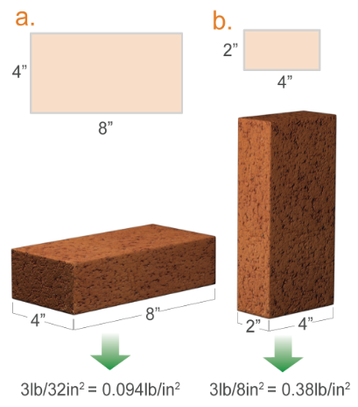
Pressure
Pressure is force per unit area.
It is the way force is distributed on a surface.
In position a, the 3-lb force of the brick is spread out over the 4 x 8 in. surface. The pressure is 3 lb/32 in.2= 0.094 lb/in².
In position b, the force is spread out over the 2 x 4 in. surface. The pressure is 3 lb/8in2 = 0.38 lb/in². Position b exerts more pressure even though the force is constant.

Slide 6
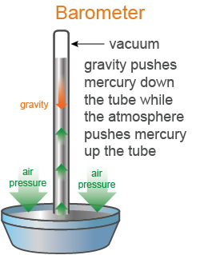
Measuring pressure
An instrument used to measure atmospheric pressure called a barometer.
Standard air pressure can push a column of mercury to a maximum height of 760 mm. This is where the pressure unit mmHg comes from.
As air pressure changes, so does the mercury column height. When air pressure decreases, it pushes less on the mercury, allowing some mercury to move from the column into the column base.

Slide 7
Dalton’s Law
Dalton's Law states that in a mixture of non-reacting gases, the total pressure exerted is equal to the sum of the partial pressures of the individual gases.
P_{tot} = P₁+ P₂ + P₃ + etc.

Slide 8
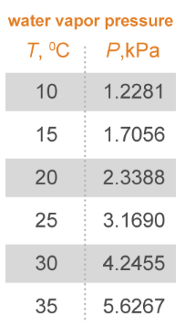
Solved problem
The total pressure in the jar is 101.325 kPa and the temperature is 25.0 °C. What is the pressure of hydrogen gas that was collected over water?
Asked | What is the pressure of hydrogen gas?
Given | P_{tot} = 101.325 kPa P₁ = 3.1690 kPa (from table)
Relationships | P_{tot}= P₁ + P₂ or P_{tot}= P_{H2O} + P_{H2}
Solve | P_{tot}= P_{H2O} + P_{H2} 101.325 kPa = 3.1690 kPa + P_{H2} P_{H2} = 101.325 kPa − 3.1690kPa = 98.156 kPa
Answer | The partial pressure of hydrogen gas is 98.156 kPa.

Slide 9
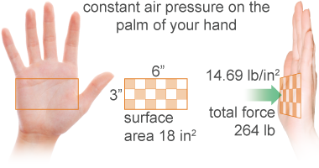
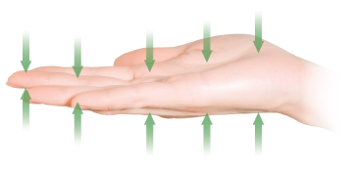
Atmospheric pressure
The pressure we experience as air pushes on everything around us is called atmospheric pressure.
If each square inch has a pressure of 14.69 lb/in² from the air, the total force on your hand is about 260 lbs!
Air particles are pushing down on your hand and pushing up on your hand at the same time.
The average pressure at sea level is called standard pressure and is equal to any of the following: 14.69 lbs/in²=14.69 psi=1.000 atm =760.0 mmHg=760.0 Torr=101.325 kPa

Slide 10
Solved problem
Convert a pressure of 1.250 atm to kPa.
Given | 1.250 kPa
Relationships | Standard pressure equivalencies: 14.69 lbs/in²=14.69 psi=1.000 atm=760.0 mmHg=760.0 Torr=101.325 kPa Conversion factor: 1.000 atm = 101.325 kPa
Solve | Use the standard pressure equivalencies to create a conversion factor:
Answer | The pressure is equal to 126.7 kPa

Slide 11
Post-assessment
How do gases produce pressure?

Slide 12
Post-assessment
How do gases produce pressure?
When gases collide with a surface, they produce a force over the area of contact.

Slide 13
Post-assessment
Do solids and liquids also produce pressure?

Slide 14
Post-assessment
Do solids and liquids also produce pressure?
Yes they do, as long as the surface of one substance contacts another there is pressure no matter what state the substances are in.

Slide 15
Post-assessment
What are some ways to increase the pressure of a gas?

Slide 16
Post-assessment
What are some ways to increase the pressure of a gas?
Increase the number of collisions or increase the force of collisions; change the surface area. This can be achieved by increasing the temperature of a gas, decreasing the size of its container, and adding more gas particles.

Slide 17
Post-assessment
How do you calculate the pressure of a system when there is more than one gas present?

Slide 18
Post-assessment
How do you calculate the pressure of a system when there is more than one gas present?
Use Dalton's law, which requires you to add all the partial pressures of each individual gas together to get the total pressure.

