Slide 1
T = Take Notes
I = Interact with your notes
P = Practice with plenty of repetition
S = Self-test

Slide 2
Chapter 11: Section 3: Gas Volumes and the Ideal Gas Law

Slide 3
Essential question
According to Avogadro's law, how are moles of a gas and its volume related when temperature and pressure are constant?

Slide 4
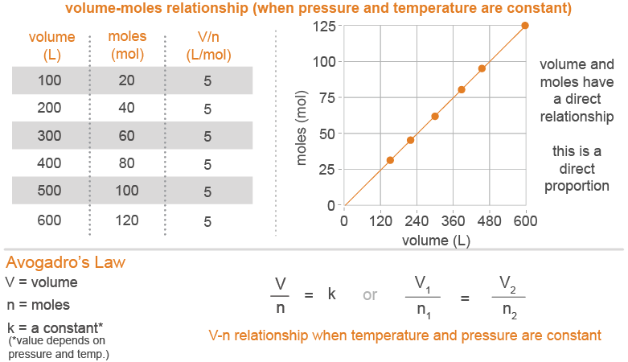
Avogadro’s law
Avogadro’s Law states that volume is directly proportional to moles when temperature and pressure are unchanging
Avogadro’s law is expressed as: V/n = a constant.

Slide 5
Solved problem
How many moles of gas were added to a balloon to cause it to expand from 5.0 L to 35.2 L at constant temperature and pressure? Initially there were 0.30 moles in the balloon.
Asked | Find n₂
Given | V₁ = 5.0 L; V₂ = 35.2 L; n₁ = 0.30 moles
Relationships
Solve
Answer | There were 590 moles of gas added to the balloon.

Slide 6
Molar volume
If two gases are at the same temperature, they must have particles with the same average kinetic energy.
The two different gas particles will exert the same force when they hit the wall of their container.
This is why at standard temperature and pressure (STP, 0 °C and 1.00 atm) one mole of any gas occupies 22.4 L. This is known as the molar volume of a gas.

Slide 7
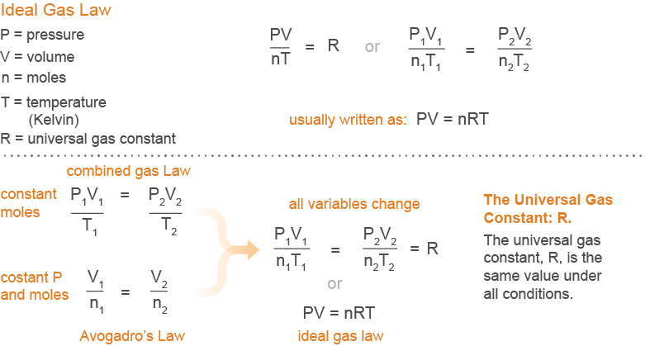
The ideal gas law
The ideal gas law, PV = nRT is an equation that works for all gases under all conditions of temperature and pressure.

Slide 8
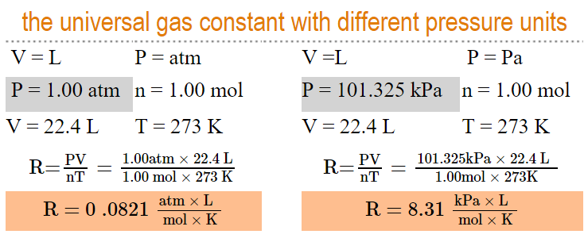
The universal gas constant, R
The universal gas constant, is a constant and represented by the letter “R”. This is a fundamental constant of nature like pi (π). The units used to calculate “R” affects its value.

Slide 9
The ideal gas law with fixed conditions
The ideal gas law is only perfectly accurate for an ideal gas.
The ideal gas law can be quite accurate for real gases of sufficiently high temperature and/or low pressure.
If you are given an ideal gas problem where the conditions are not changing, use the PV = nRT version of the ideal gas law

Slide 10
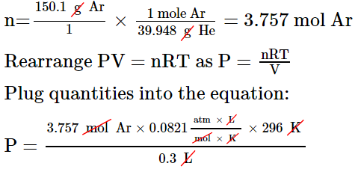
Solved problem
What is the pressure in a 300.0 mL container filled with 150.1 g of argon gas at 23.0 °C?
Asked | What is the tank pressure under these unchanging conditions?
Given | V = 300.0 mL; mass = 150.1 g Ar; T= 23.0 °C
Relationships | PV = nRT, , and molar mass of Ar = 39.948 g/mol
Solve | Convert the given quantities to match the units of R: Convert volume to liters; convert temperature to K and mass to moles. V = 0.300 L, T = 296 K
Answer | The pressure of the tank is 304 atm.

Slide 11
The ideal gas law with varying conditions
Because the ideal gas law contains all the other gas laws within itself, you only need this one formula to solve any problems related to gases. You just need to choose the correct version of the formula.
Step 1: Simplify
You can simplify the equation by cancelling out anything that stays constant. For example, if volume is not changing, then V₁ and V₂ both cancel out.
Step 2: Solve
Plug in known quantities for remaining variables in the simplified equation and solve for the unknown variable.

Slide 12
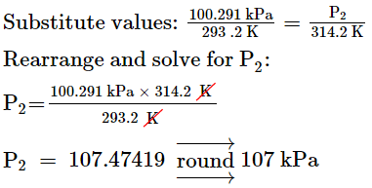
Solved problem
How high does the pressure of a sealed bag of pretzels at 100.291 kPa get when you move it from inside a 20.2 °C grocery store to your car, which is 41.2 °C inside?
Asked | What is the new pressure of the bag under changing temperature conditions?
Given | P₁ = 100.291 kPa; T₁ = 20.2 °C; T₂ = 41.2 °C
Relationships | 20.2 °C = 293.2 K; 41.2 °C = 314.2 K; Ideal gas law under changing conditions:
Solve | Neither moles nor volume are changing, so you can cancel both from the equation:
Answer | The pressure in the bag will go up to 107 kPa.

Slide 13
Post-assessment
According to Avogadro's law, how are moles of a gas and its volume related when temperature and pressure are constant?

Slide 14
Post-assessment
According to Avogadro's law, how are moles of a gas and its volume related when temperature and pressure are constant?
When temperature and pressure are held constant, moles and volume are directly related. As the number of moles increase, so does volume.

Slide 15
Post-assessment
If there is really no such thing as an ideal gas, why is there an ideal gas law?

Slide 16
Post-assessment
If there is really no such thing as an ideal gas, why is there an ideal gas law?
Gases behave nearly ideal enough for the ideal gas law to predict approximate behavior

Slide 17
Post-assessment
Which gas laws are incorporated into the ideal gas law?

Slide 18
Post-assessment
Which gas laws are incorporated into the ideal gas law?
Avogadro's law, Boyle's law and Charles' law

Slide 19
Post-assessment
How does the ideal gas law get revised under fixed conditions compared to varying conditions?

Slide 20
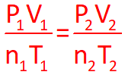
Post-assessment
How does the ideal gas law get revised under fixed conditions compared to varying conditions?
You need to know both forms of the ideal gas law. Use PV=nRT when conditions are fixed, and use under changing conditions. In the changing conditions equation, an unchanging variable disappears from the equation

