Slide 1
T = Take Notes
I = Interact with your notes
P = Practice with plenty of repetition
S = Self-test

Slide 2
Chapter 10: The Kinetic-Molecular Theory of Matter

Slide 3
EssentIal questions
Describe as many assumptions of the kinetic molecular theory as you can.
If there is really no such thing as an ideal gas, why is there an ideal gas law?
Which gas laws are incorporated into the ideal gas law?
How does the ideal gas law get revised under fixed conditions compared to varying conditions?

Slide 4
Kinetic molecular theory
Particle motion - Gases particles act like spheres that are constantly moving in random directions.
Particle collisions - Each gas particle travels in a straight line until it either strikes another particle or it hits the walls of its container.
Particle size - Gas particles are tiny. There is always plenty of space between a gas particle and a neighboring particle or container wall.
Attractive and repulsive forces - The motion of one gas particle is not influenced by either attractive or repulsive forces of neighboring gas particles.
Elastic collisions – The collisions of gas particles are elastic, meaning there is no net loss of energy from the system.
Kinetic energy. The average kinetic energy of any gas sample depends directly on the temperature of the gas.

Slide 5
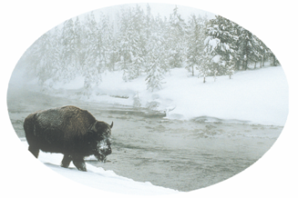
Changes of State
Familiar weather events can remind you that water exists on Earth as a liquid, a solid, and a vapor. As water cycles through the atmosphere, the oceans, and Earth’s crust, it undergoes repeated changes of state. You will learn what conditions can control the state of a substance.

Slide 6
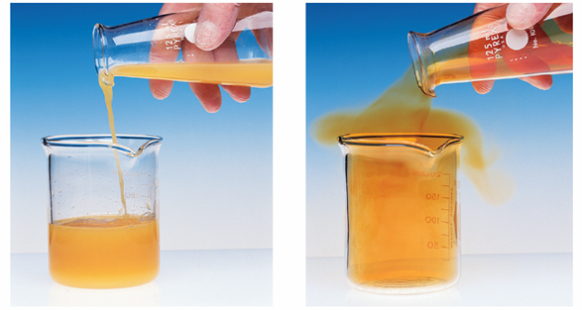
A model for liquids
What factors determine the physical properties of a liquid?
Substances that can flow are referred to as fluids. Both liquids and gases are fluids.

Slide 7
Physical properties of liquids
The movement of particles in a liquid and the attractions among the particles determines the physical properties of liquids.
The conversion of a liquid to a gas or vapor is called vaporization.
When such a conversion occurs at the surface of a liquid that is not boiling, the process is called evaporation.

Slide 8
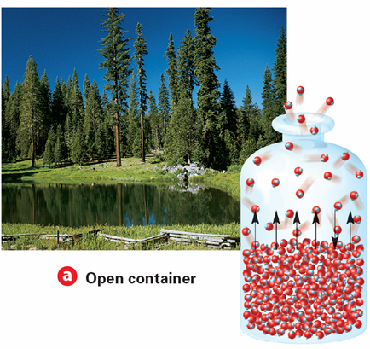
Evaporation in an open container
In an open container, molecules that evaporate can escape from the container.

Slide 9
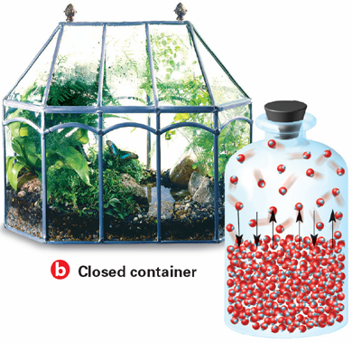
Evaporation ion a closed container
In a closed container, the molecules cannot escape. They collect as a vapor above the liquid. Some molecules condense back into a liquid.

Slide 10
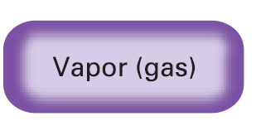
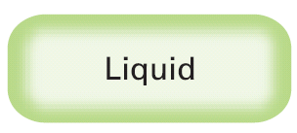
Vapor Pressure
13.2
Vapor pressure is a measure of the force exerted by a gas above a liquid.

Slide 11
A Model for Solids
How are the structure and properties of solids related?
The general properties of solids reflect the orderly arrangement of their particles and the fixed locations of their particles.

Slide 12
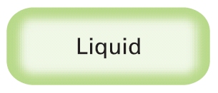
Melting point
The melting point (mp) is the temperature at which a solid changes into a liquid.
The melting point (mp) is the temperature at which a solid changes into a liquid.

Slide 13
Sublimation
When can sublimation occur?
The change of a substance from a solid to a vapor without passing through the liquid state is called sublimation.
Sublimation occurs in solids with vapor pressures that exceed atmospheric pressure at or near room temperature.

Slide 14
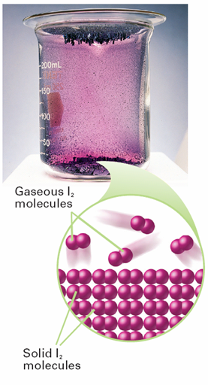
Sublimation
When solid iodine is heated, the crystals sublime, going directly from the solid to the gaseous state. When the vapor cools, it goes directly from the gaseous to the solid state.
Notes:
When solid iodine is heated, the crystals sublime, going directly from the solid to the gaseous state. When the vapor cools, it goes directly from the gaseous to the solid state.

Slide 15
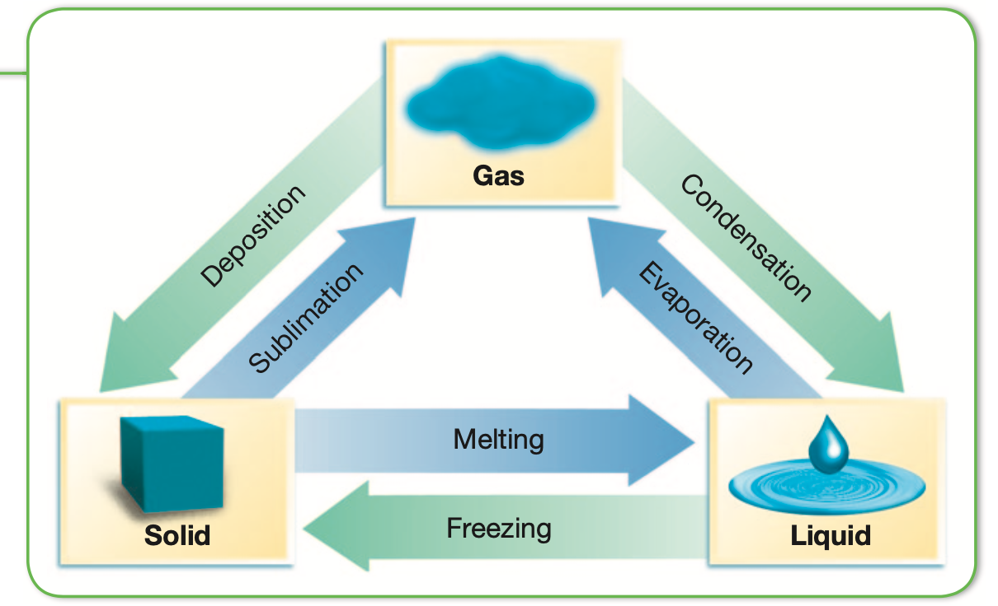
Changes of state

Slide 16
Phase Diagrams
How are the conditions at which phases are in equilibrium represented on a phase diagram?
A phase diagram is a graph that gives the conditions of temperature and pressure at which a substance exists as solid, liquid, and gas (vapor).

Slide 17
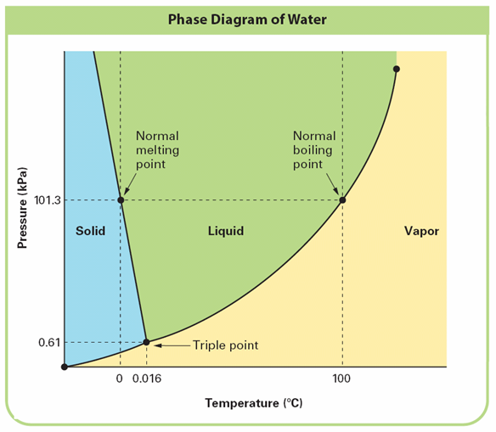
Notes:
The conditions of pressure and temperature at which two phases exist in equilibrium are indicated on a phase diagram by a line separating the phases.

Slide 18
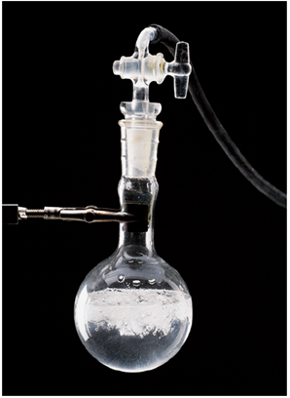
Triple point
The triple point describes the only set of conditions at which all three phases can exist in equilibrium with one another.
Notes:
At the triple point, ice, liquid water, and water vapor can exist at equilibrium. Freezing, melting, boiling, and condensation can all occur at the same time, as shown in the flask.

Slide 19
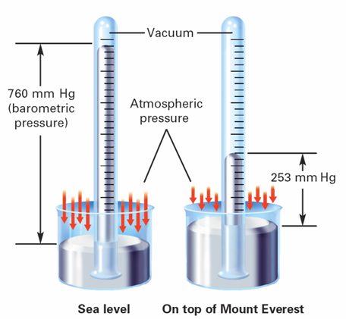
Gas Pressure
A barometer is a device that is used to measure atmospheric pressure.
Notes:
At sea level, air exerts enough pressure to support a 760-mm column of mercury. On top of Mount Everest, at 9000 m, the air exerts only enough pressure to support a 253-mm column of mercury. Calculating What is the decrease in pressure from sea level to the top of Mount Everest?

Slide 20
Standard pressure
The SI unit of pressure is the pascal (Pa).
One standard atmosphere (atm) is the pressure required to support 760 mm of mercury in a mercury barometer at 25°C.

Slide 21
Post-assessment
Describe as many assumptions of the kinetic molecular theory as you can.

Slide 22
Post-assessment
Describe as many assumptions of the kinetic molecular theory as you can.
Gases are constantly moving at random; particles travel in a straight line until they collide with something; collisions are elastic because energy is conserved; particles are tiny; there are no attractive or repulsive forces between particles; the average kinetic energy depends only on gas temperature

