Slide 1
T = Take Notes
I = Interact with your notes
P = Practice with plenty of repetition
S = Self-test

Slide 2
Chapter 1: Section 2: Physical and Chemical changes

Slide 3
Essential Question
What distinguishes a chemical change from a physical change?

Slide 4
Physical Properties and Changes
A property you can measure with tools or your senses is called a physical property.
A physical change is a change in the physical properties of matter.

Slide 5
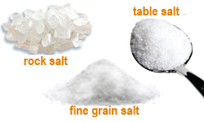
Thinking about physical change
A physical change occurs when matter undergoes a change and it is still chemically the same as it was before.
Crushing or grinding into powder and drying wet clothes are both examples of physical change.

Slide 6
Chemical changes
In a chemical change, where there is a chemical reaction, atoms in a substance rearrange to make a new substance and energy is either given off or absorbed.

Slide 7
Chemical properties
A property that can be observed when one substance changes into a different substance is called a chemical property.
Iron reacts with oxygen gas and makes a new substance. Iron, Fe, is a different substance than rust, Fe₂O₃.

Slide 8
Clues for chemical change
A chemical change occurs during a chemical reaction. A chemical reaction is any process in which one substance changes into a different substance.

Slide 9
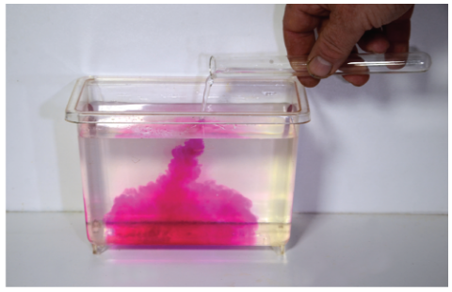
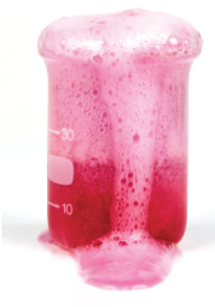
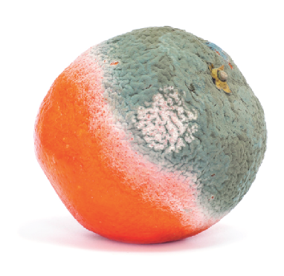
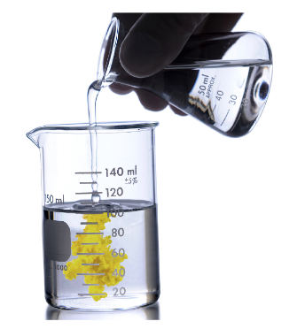
Signs of a chemical change
The following signs may indicate a chemical change has occurred:
Color change
Bubble/gas formation
Odor change
Precipitate formation
Energy change

Slide 10
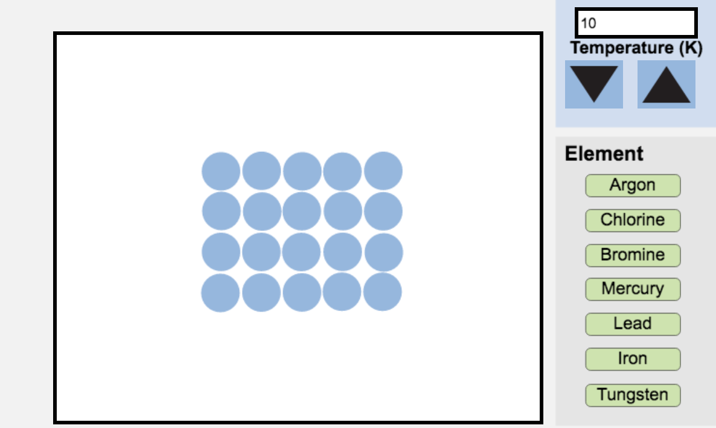
Interactive
Explore what happens to atoms as you change the temperature and they transition through three phases in the interactive simulation titled Phases of Matter.

Slide 11
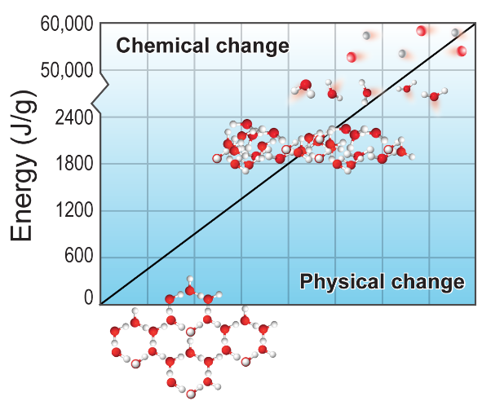
Energy and change
The forces that hold particles together in solids and liquids are called intermolecular forces (IMFs).
- Physical phase changes involve only intermolecular forces.
Interatomic forces hold the atoms together within a molecule.
- Chemical changes involve interatomic forces because bonds between atoms change during chemical change.

Slide 12
Post-assessment
What distinguishes a chemical change from a physical change?

Slide 13
Post-assessment
What distinguishes a chemical change from a physical change?
If a substance with a different chemical formula is formed, a chemical change has occurred.

